Slide 1
QHY174 Calibration
How, Why, Best Practices
2020-07-26
Notes:
So I’d like to talk a bit about calibration on the QHY174-GPS cameras -- what it is, how to do it, why we should do it, and what we know (or at least I know) about it. A few words before we start: this presentation generally references the almost-latest version of SharpCap, 3.2.6383 of July 3 -- apparently a newer version came out Wednesday -- but occasionally I do refer to other versions. All versions I reference are 32-bit. Also, much of this talk is educated guesses, others may know more, I may talk about problems that you haven’t seen, your mileage may vary, etc., so let me know at the end how your experiences differ. Lastly, I will be taking a deep dive and covering a lot of problems here, but if I leave you in the weeds, just know that I do have three slides near the end that are a cheat-sheet of best practices. They won’t fix everything I talk about unfortunately, but they do at least deal with as many of the problems that I am both aware of and know how to address at this point. I will also of course make the presentation slides available. With that said, let’s begin.

Slide 2
What is QHY174 calibration?
On-camera method of finding camera delay and compensating for it
Want to know this delay for any camera, even QHY with its internal GPS
Most trusted answer is from separate optical timing system like SEXTA
QHY provides an on-camera method that is also optical based
Notes:
So, what is calibration? For QHY174 cameras, it’s an on-camera method of finding the camera delay -- of course that’s the delay between the actual optical start/end of exposure and the timestamped start/end of exposure -- and compensating for it. We of course want to know what the delay is for any occultation camera; even ones with internal GPS could have a delay between actual and recorded exposure time. So the most trusted answer for this would be from a separate optical timing system like a SEXTA array. But the QHY provides an on-camera method that is also optical based; we’ll explore that in a moment.

Slide 3
Why calibrate?
Timestamp accuracy
Exposure accuracy -- can be off by 100ms+ if calibration way off
Avoid complete timestamp loss (frozen and/or BadCalibrationReduceEndPos)
Correct calibration changes with setting changes:
Exposure
Binning
Capture Area (vertical extent)
Color Space (MONO8 vs MONO16)
USB Traffic (also USB2 vs USB3 ports)
Start/End Pos (the actual calibration settings)
Notes:
But first, why do we want to calibrate? Well, timestamp accuracy obviously. QHY docs say the calibration procedure can get us to microsecond precision. That’s obviously more than we need. But how far off are we when uncalibrated? Turns out it can be quite a bit Exposure accuracy is another reason to calibrate: sometimes the GPS window reported exposure can vary significantly from the GUI-set exposure, by tens or hundreds of milliseconds. This can be due to wildly-off calibration. Avoiding complete loss of timestamps is a big reason to calibrate: depending on which direction the calibration is off, even a slight amount can lead to the GPS timestamp freezing and not updating -- the dreaded BadCalibrationReduceEndPos error that we’ll talk about -- leaving us with only the PC-reported timestamps at best. Also, calibration can change with settings: the correct calibration value varies -- substantially in some cases -- whenever the following settings are changed: Exposure, Binning, Capture Area (the vertical extent), USB traffic (also USB2 vs USB3, if one is forced to use USB2 ports), and of course Start and End Pos -- the actual calibration settings themselves.

Slide 4
How to Calibrate
Notes:
So how do we calibrate?

Slide 5
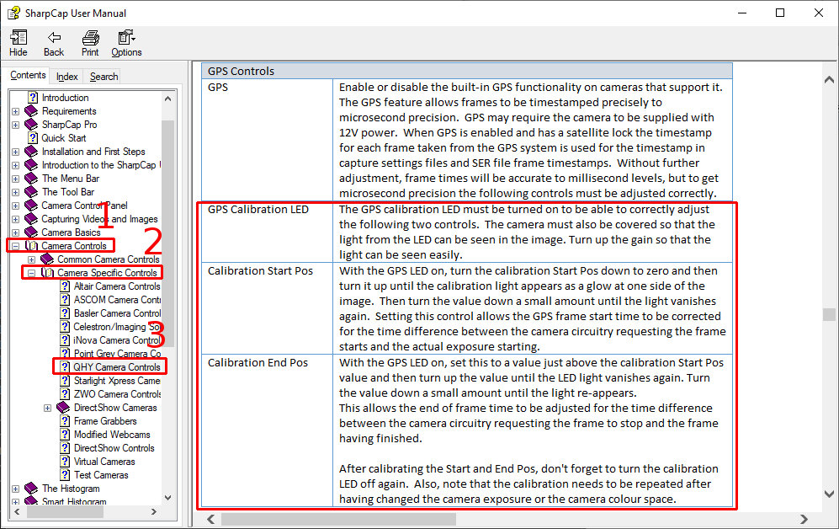
Notes:
The procedure is briefly described in the SharpCap help: Camera Controls -> Camera Specific Controls -> QHY Camera Controls, Enter, scroll to GPS Controls. Calibration is also talked about on the QHY site, but it may be more nebulous and confusing there. And neither source really details what’s going on. In my opinion...

Slide 6
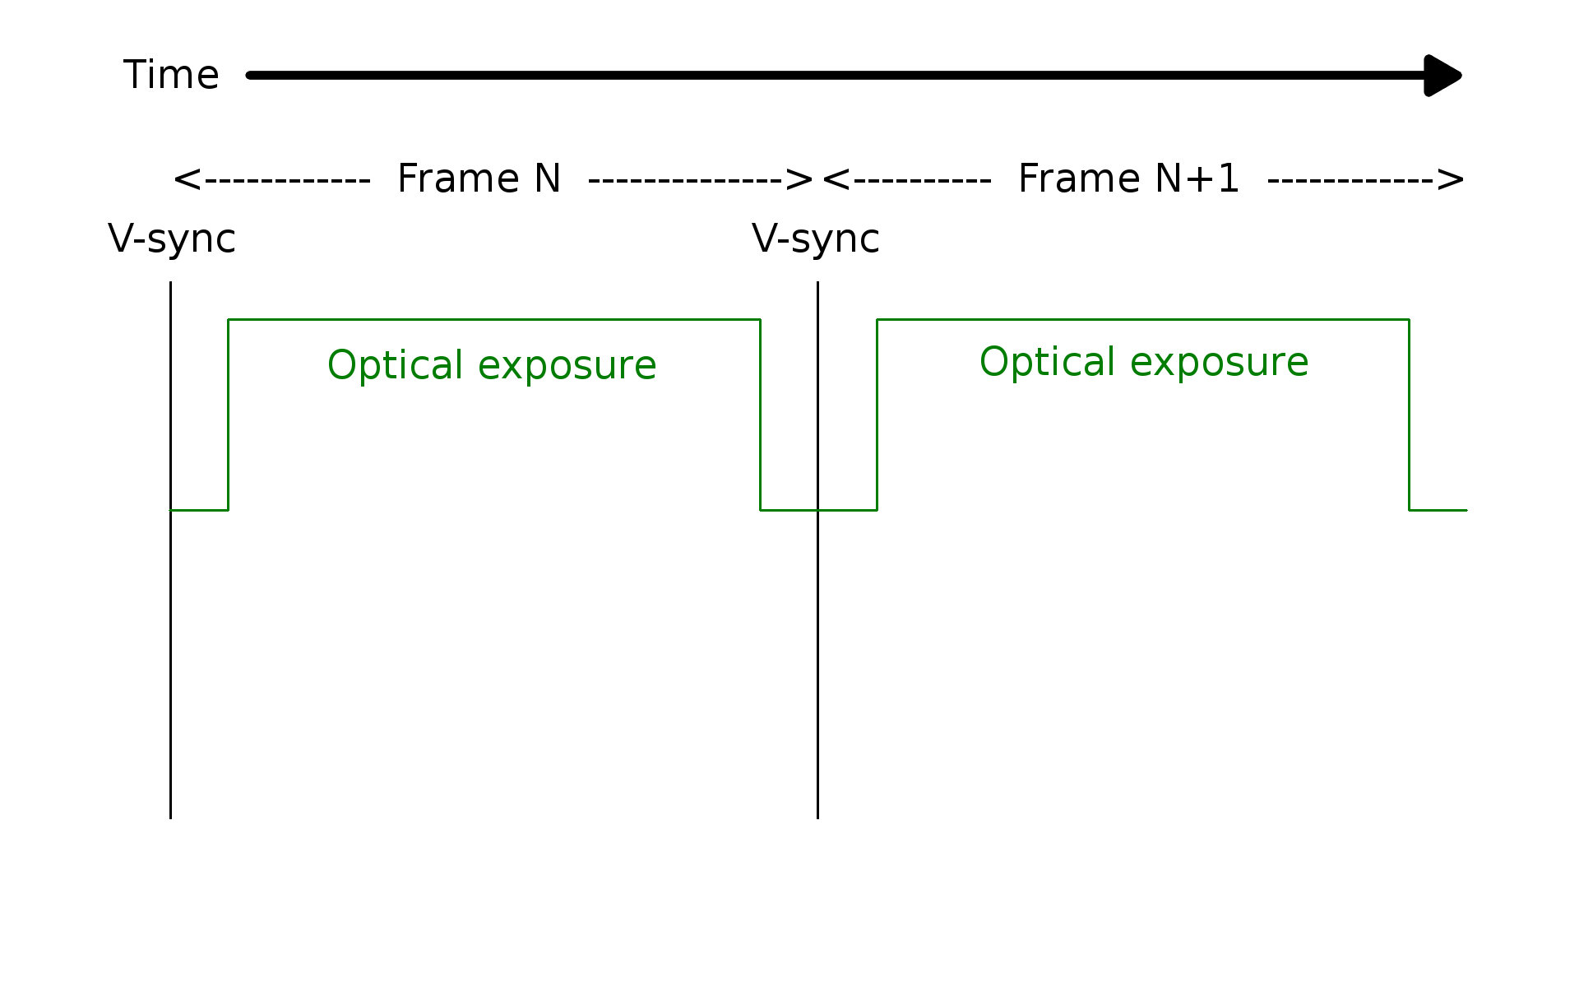
Notes:
...so let’s start with some background on what’s happening -- at least what I think is happening -- and what our goal is. This is a plot of exposure vs time in the camera, for two adjacent frames, since the frame sequence is continuous. When the green line rises, the camera is actually exposing; when it is low, it is not. While the camera commands start-exposure at frame start (i.e. the vertical sync line), the actual optical start of exposure might be slightly later, due to delays in the electronics or whatever -- hence the gap between v-sync and the green line rise here. It’s also I think roughly the same for end of exposure, though I may be simplifying things here.

Slide 7
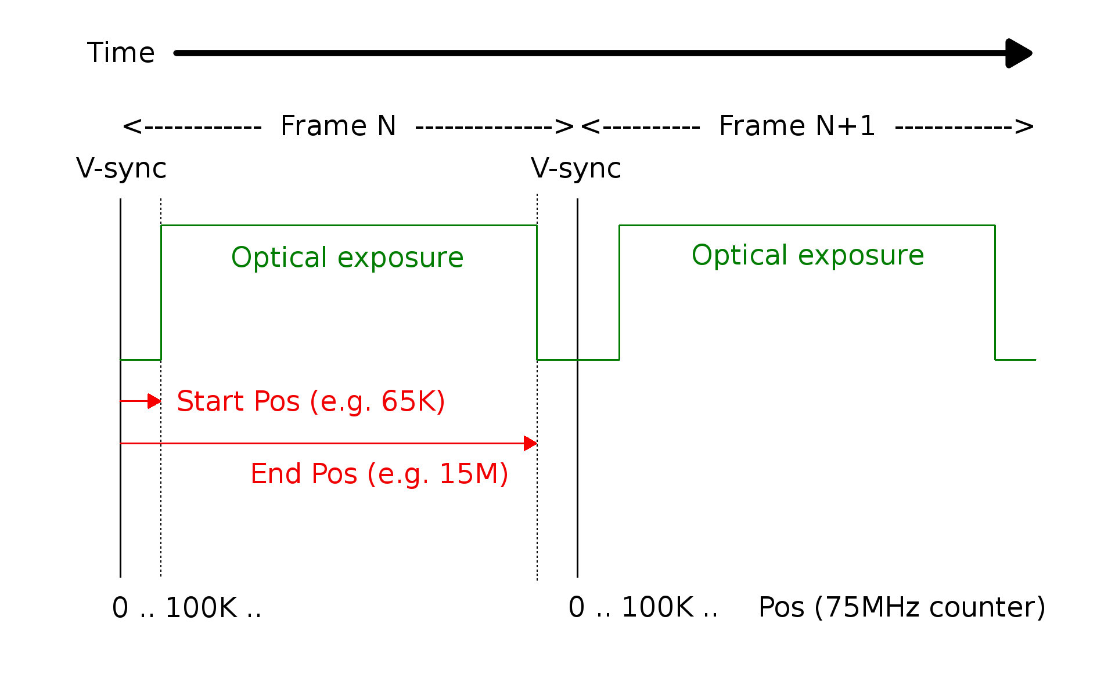
Notes:
So our goal is to find exactly what those time offsets are, for start and end exposure, from the vertical sync. In the SharpCap GUI, they’re known as the calibration Start Pos and End Pos. And they are defined in terms of the counts on a 75MHz clock on the camera that resets to 0 at every v-sync.

Slide 8
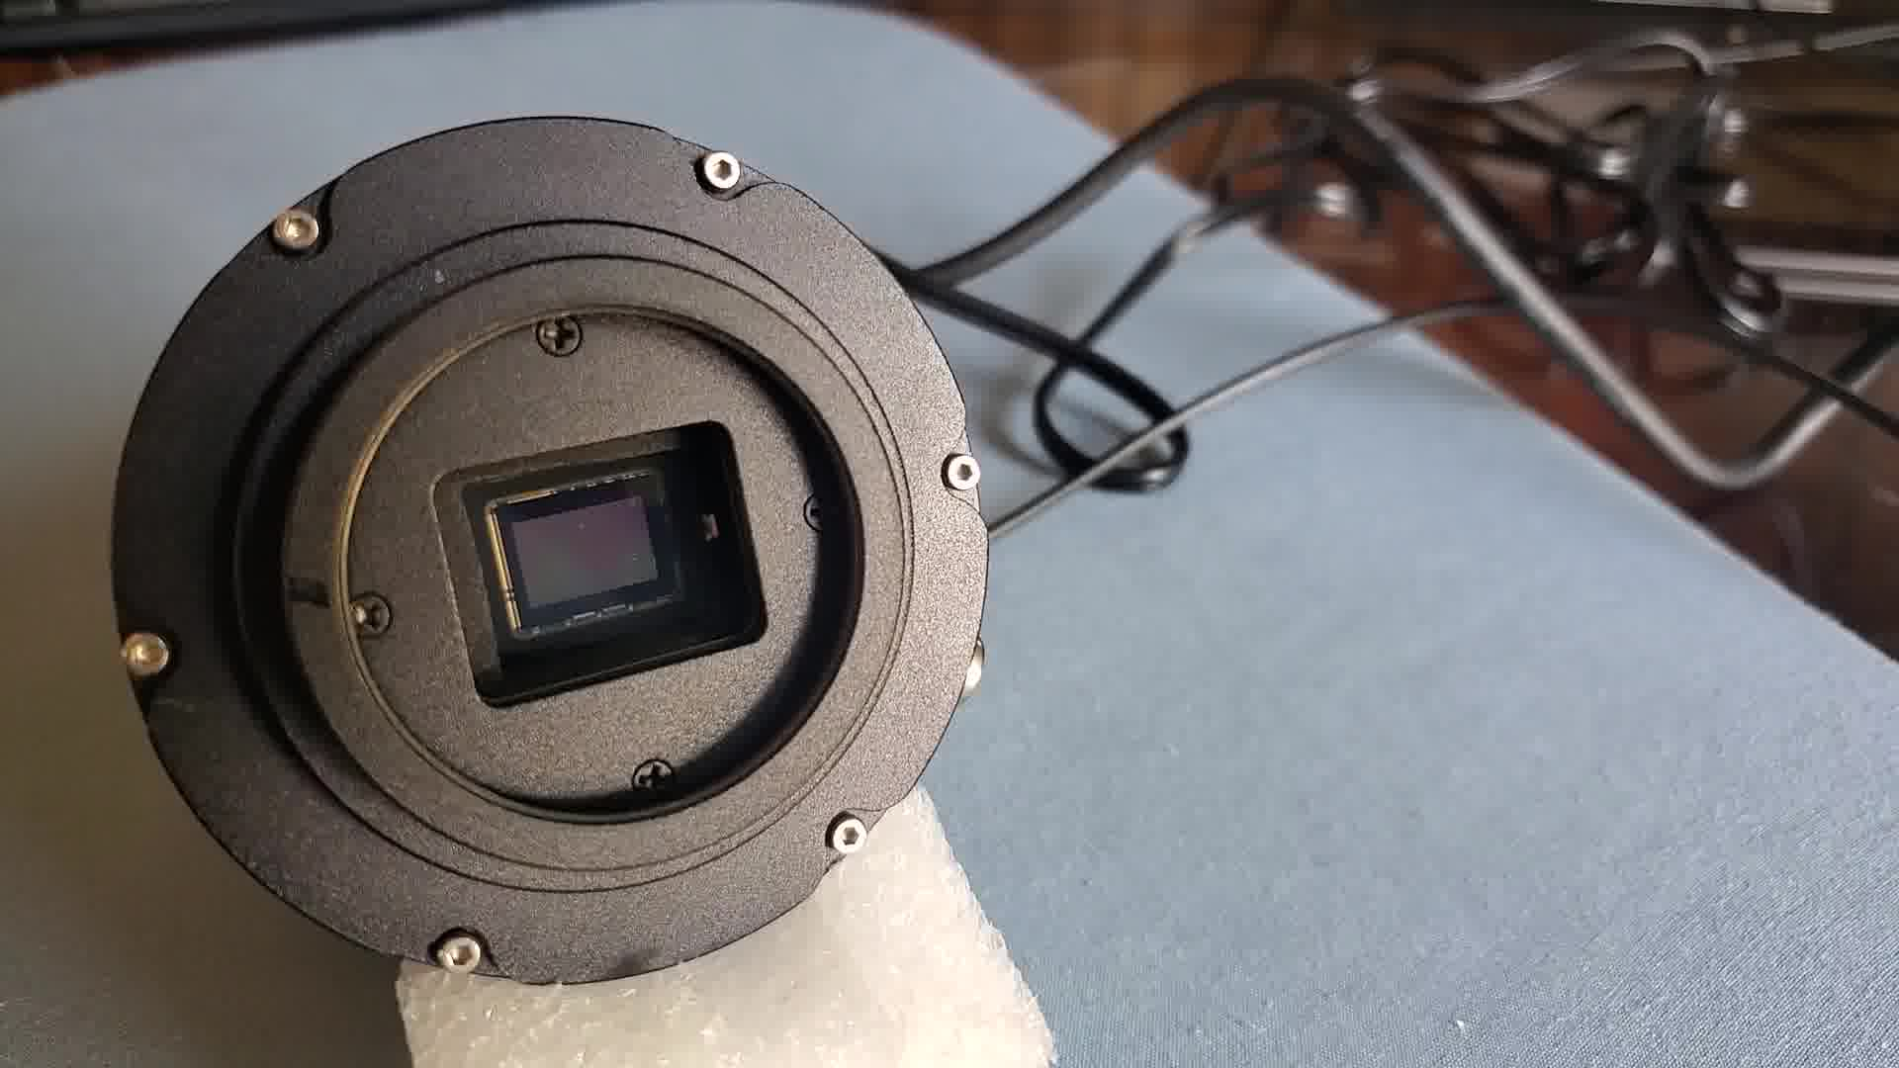
Notes:
To find the optical start of exposure, we need an optical source. So the QHY cameras have a calibration LED, as mentioned earlier. It’s in front of the CMOS chip, the white dot on the right here. This keeps it out of the field of view, but still able to shine on the chip...

Slide 9
Notes:
...when lit as we see here. Of course we do this with the camera or telescope covered, so we don’t swamp the LED signal with daylight. Note of course that it is constantly blinking once per frame, not steadily on as in this still picture.

Slide 10
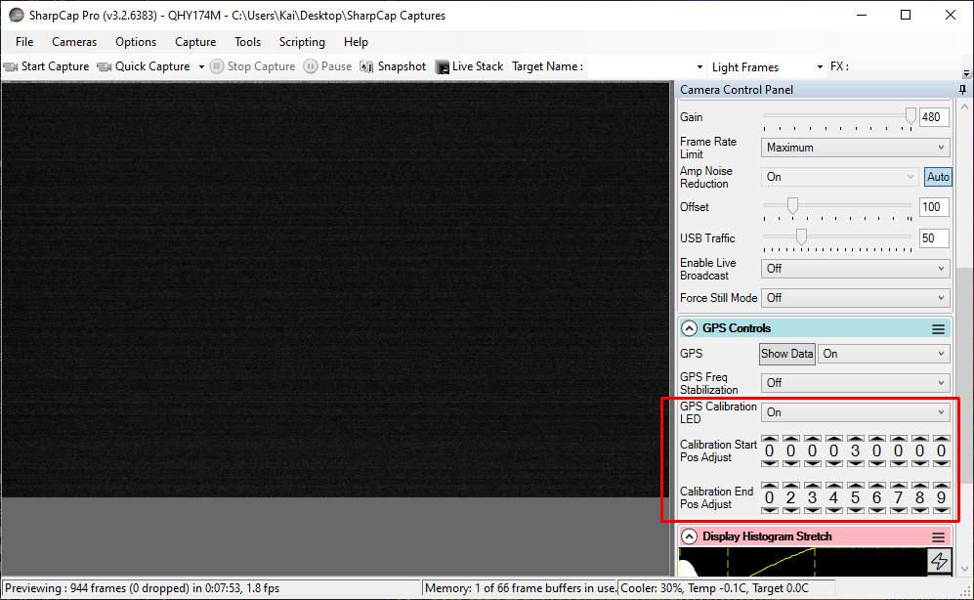
Notes:
To adjust this LED, SharpCap gives us three controls: GPS Calibration LED, which enables or disables the LED blink; Calibration Start Pos Adjust, which adjusts when the blink occurs for the start of exposure, and Calibration End Pos Adjust which adjusts when it blinks for end of exposure. The values for Start and End Pos are the values for that 75MHz clock counter, i.e. offsets from vertical sync for when to blink the LED. The blink is very short -- less than half a microsecond -- and always this length. And there is only one blink per frame -- all we are doing by setting Start and End Pos is adjusting when the blink occurs during the frame, and whether the blink is used to mark start or end of exposure.

Slide 11
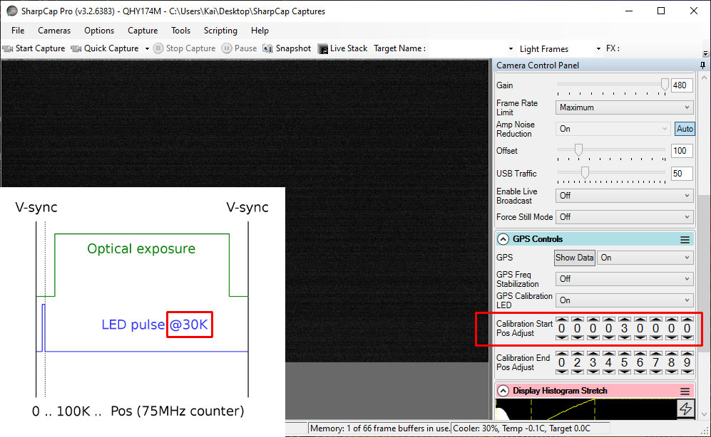
Notes:
We enable the LED with the GPS Calibration LED control, and then adjust these counters one at a time, starting with Start Pos. First we set it real low -- possibly all the way to 0 per the docs, but maybe not for reasons I’ll go into later. For SharpCap 3.2.6226 and later, Start (and End) Pos will already be pre-set to a “best guess”, but again we may still need to turn it down first. That’s because the goal for Start Pos is to find the start of the exposure -- the rise in the green line here -- and for consistency the docs have us start from below, when the LED is off (or more properly, invisible). We see nothing in the exposure here: that is because while the LED is blinking, it is blinking at a time is before the exposure. In this case, 30K is our start point, and happens to fall within that pre-exposure range -- so we don’t see the LED yet. If we were to uncover the camera chip and look right now however, we would see the tiny LED blinking (because our eyes are continuously exposing, unlike the CMOS chip).

Slide 12
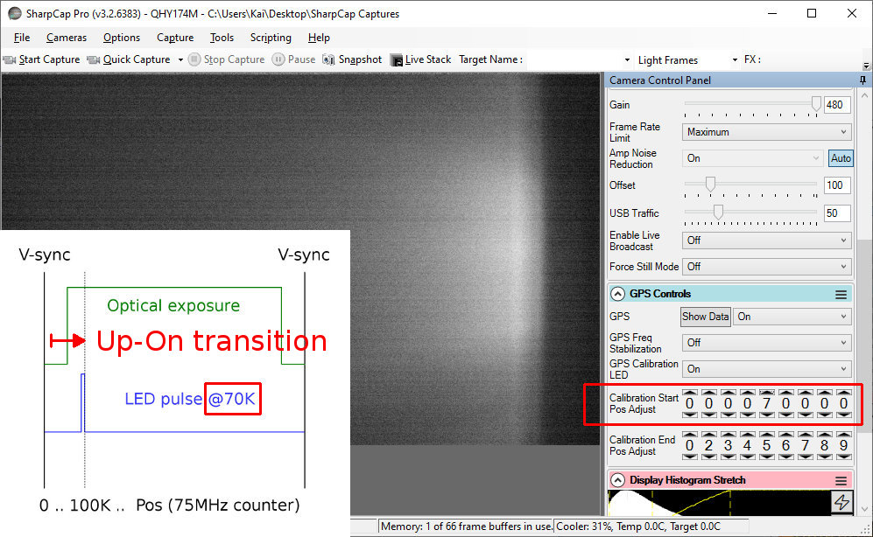
Notes:
Now we start increasing Start Pos, which moves the LED blink time later in the frame timing sequence. Eventually we reach a point where the LED is on (visible). This means we’ve moved the LED pulse to inside the optical exposure range; in this case, 70K happens to fall within that range. Since moving the counter up made the LED go on, I call this an Up-on transition. An up-on LED transition indicates the start of exposure.

Slide 13
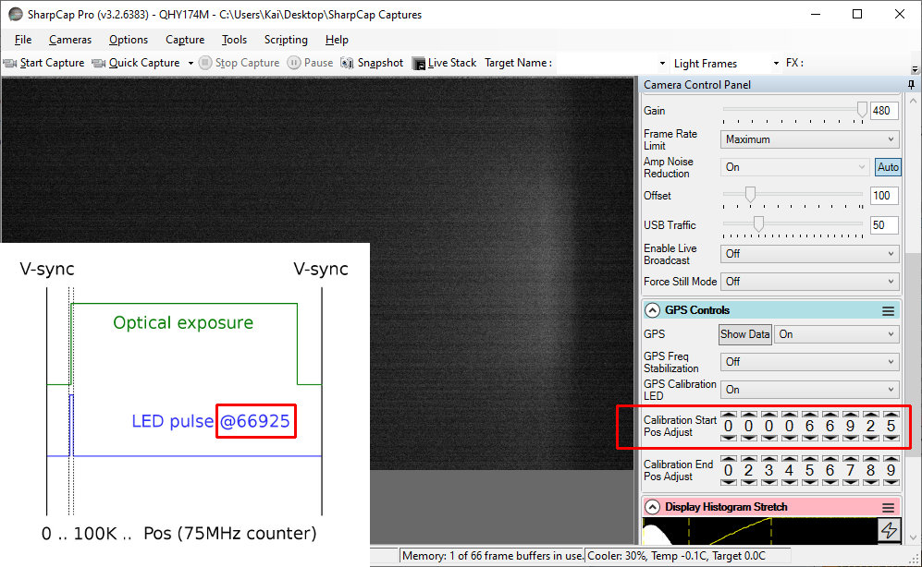
Notes:
Now we want to find the exact spot of that transition, so we back down slowly. At some point, with smaller and smaller counter changes, we see the LED only partially on, as here: the blue pulse width is bracketing the green start of exposure. Note that we might bounce back and forth across the transition with large counter value changes up and down, until we narrow it down with smaller changes. This partially-on range for the LED -- from fully off to fully on -- spans about 40 counter values: the width of the LED pulse. 40 divided by 75MHz is just under half a microsecond -- again, the width of the LED pulse..

Slide 14
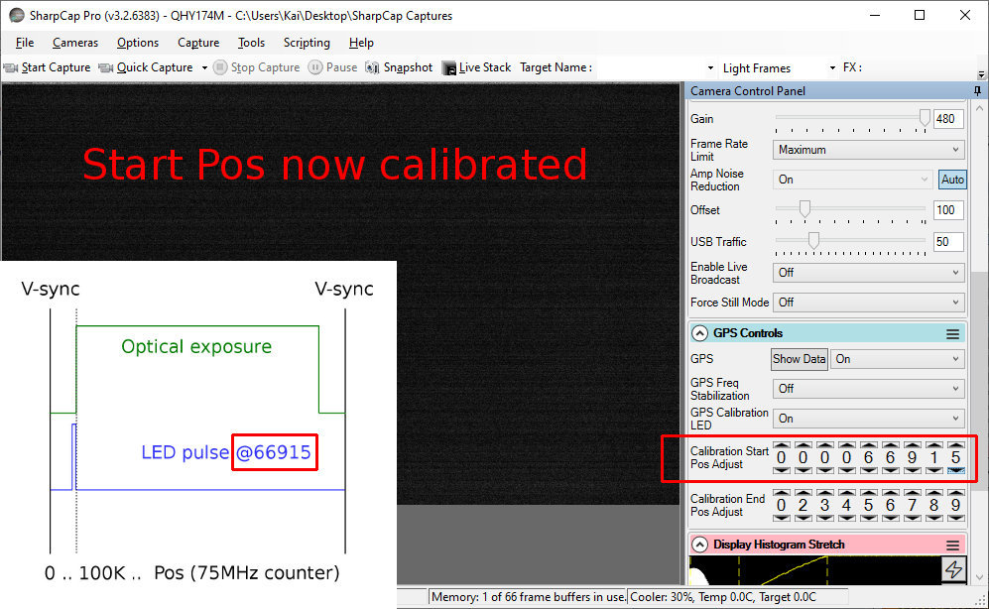
Notes:
Finally, once we’ve found the transition, we fine-tune Start Pos so that the LED is just barely completely off, i.e. the LED pulse finishes just before the exposure. Now we’ve got Start Pos calibrated.

Slide 15
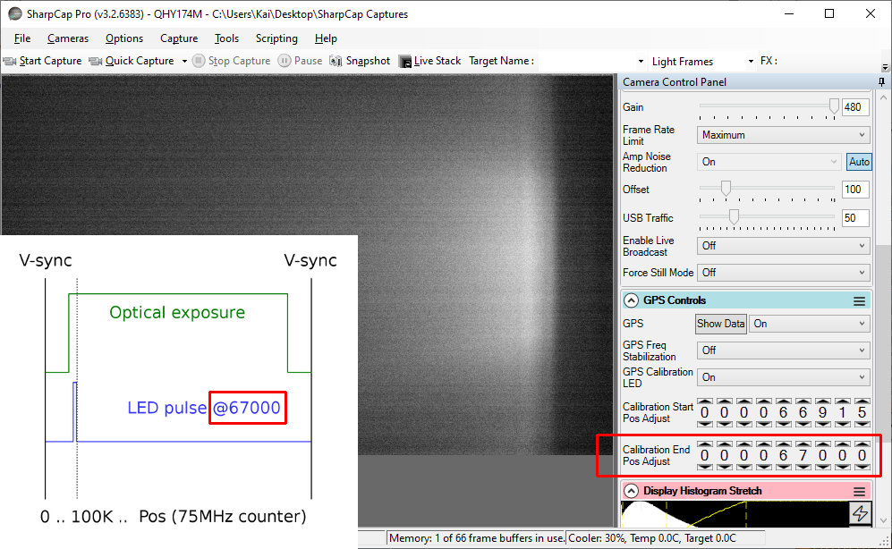
Notes:
Next, we do much the same with End Pos. However, now we are looking for the end of exposure. We start with a value just above the calibrated Start Pos we found, per the docs. Or, in SharpCap 3.2.6226 or later, End Pos might already be preset to a best guess. Either way, again for consistency, we want to approach the transition from below, so we start with a low End Pos -- but still above Start Pos -- that shows the LED on, as here. This is opposite of what we did for Start Pos, where we started with the LED off (invisible), because for End Pos we are looking for end of exposure.

Slide 16
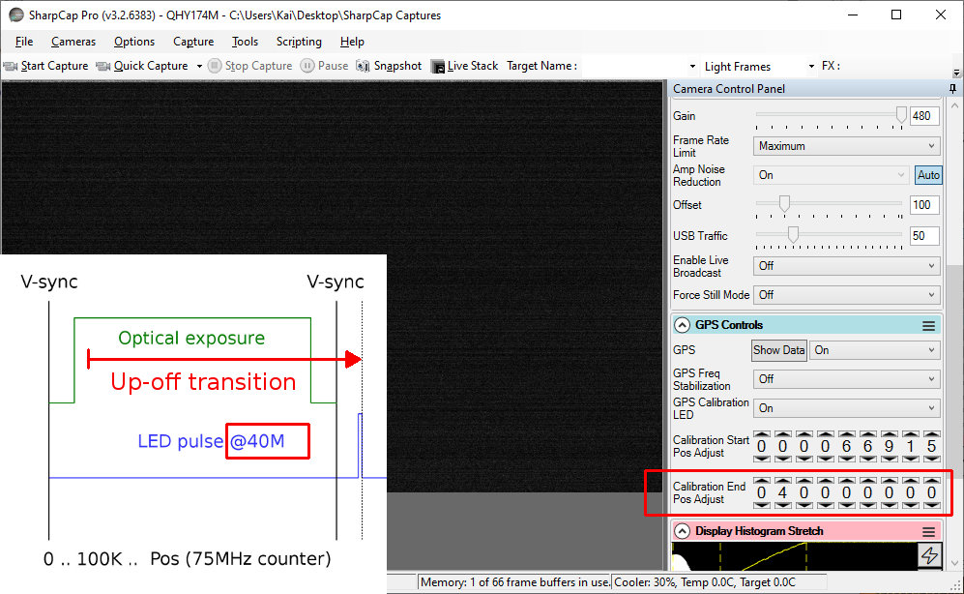
Notes:
We proceed to increase End Pos, until we see the LED go off. The LED going off means we’ve moved the LED blink time to outside the exposure window. Since moving the counter up made the LED go off, I call this an Up-off transition. An up-off transition indicates the end of exposure.

Slide 17
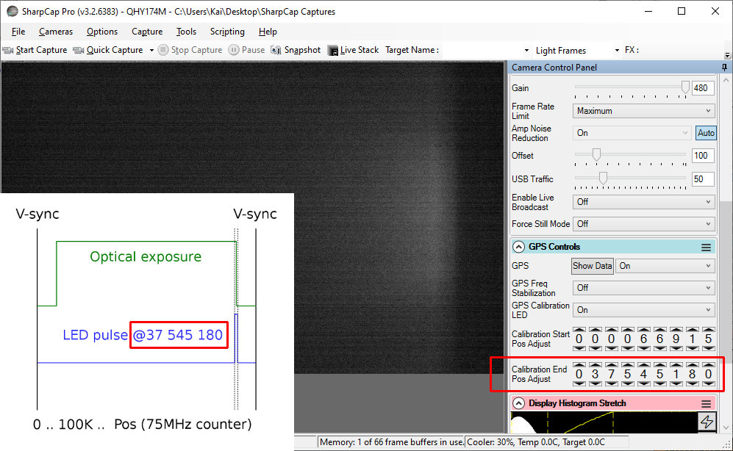
Notes:
As before, we now back down slowly to find the exact point of that transition. At some point, with smaller and smaller counter changes, we again see the LED only partially on, as here -- again possibly after bouncing back and forth over the transition with smaller and smaller changes. We’re right on the transition now...

Slide 18
Notes:
...and once again, we back down just a tiny bit until the LED is just barely completely lit, per the docs. I.e. the LED pulse just finishes before end of exposure. Now we’ve got End Pos calibrated as well. We can turn off GPS Calibration LED, and save our profile as calibrated for these settings (i.e. Exposure, Binning, Capture Area, Color Space, USB Traffic). The firmware will use our Start and End Pos values as the exact offset from the time of v-sync, to timestamp start and end of exposure. So, this is how calibration is supposed to work. It doesn’t always go this way, and we’ll address those problems that occur during calibration soon. But first...

Slide 19
Calibration Problems I
Common issues and the SharpCap changes they caused
Notes:
...let us side-quest and look at a few of the problems that require calibration in the first place, which many of us never had to do before...

Slide 20
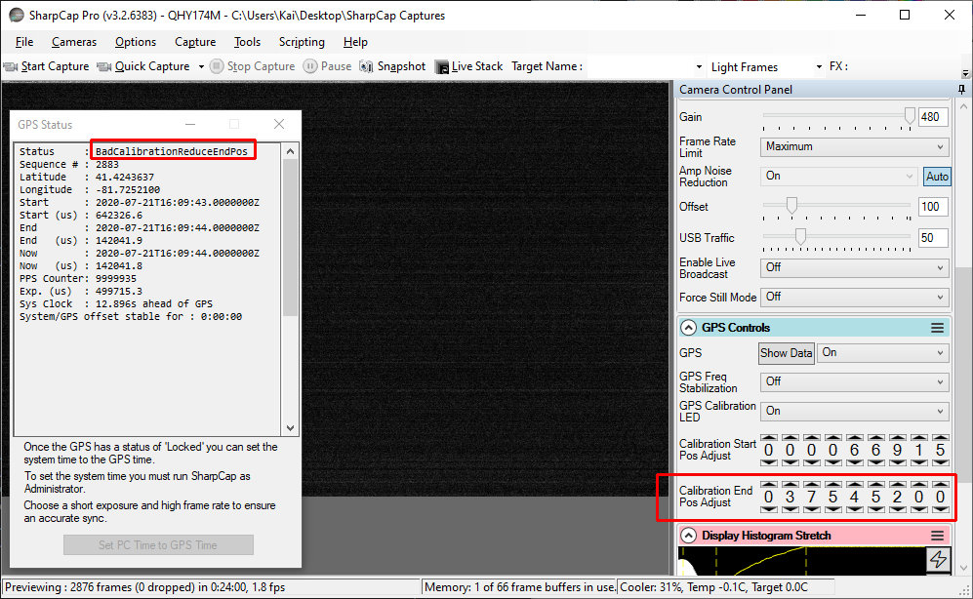
Notes:
The most common issues we’ve probably seen are these: a BadCalibrationReduceEndPos error in the GPS status when starting up or changing settings, or worse...

Slide 21
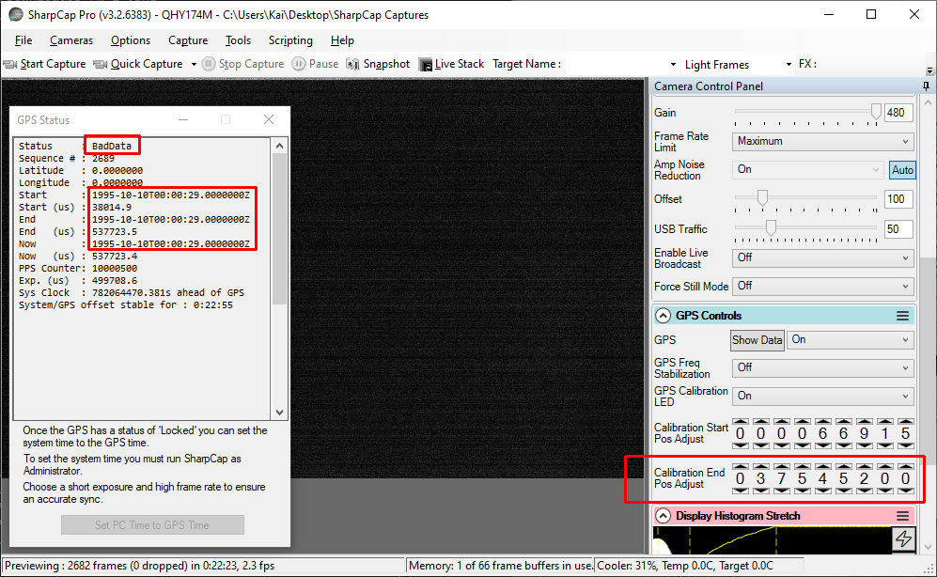
Notes:
...frozen GPS timestamps that never update. They may be old, like 1995 as shown here, or recent, but the key is they don’t update, as seen by the same value for Start, End, and Now, and for every frame. Frozen timestamps may be accompanied by BadCalibrationReduceEndPos, or sometimes a BadData error as we shall see; they could even say Locked in some older versions I believe. We’ll get back to these and other problems soon, but first, we’ll continue the side quest and look at the consequences of these and related problems for SharpCap development.

Slide 22
Calibration needed more often
Users were having timestamp issues, often not seen earlier
Robin Glover (SharpCap author) said the QHY SDK seems to have changed:
“... it looks like the way that the calibration needs to be done has changed … [V]alues of a few thousand were sufficient [once], but now values in the millions seem to be the correct result.”
Also: “... we discovered that if you don't have accurate calibration ... the GPS system can be badly off (much more than you would think if you had the idea that the calibration was just [a] fine tuning mechanism).”
Notes:
So, issues like these seem to have cropped up more and more recently. Users were having calibration-related problems, as noted on the SharpCap forums. Robin Glover (the author of SharpCap) noted that the QHY SDK seemed to have changed: the values needed for correct calibration used to be in the thousands, now they needed to be in the millions. And he also said bad calibration could lead to significant timing issues. Both of these were significant.

Slide 23
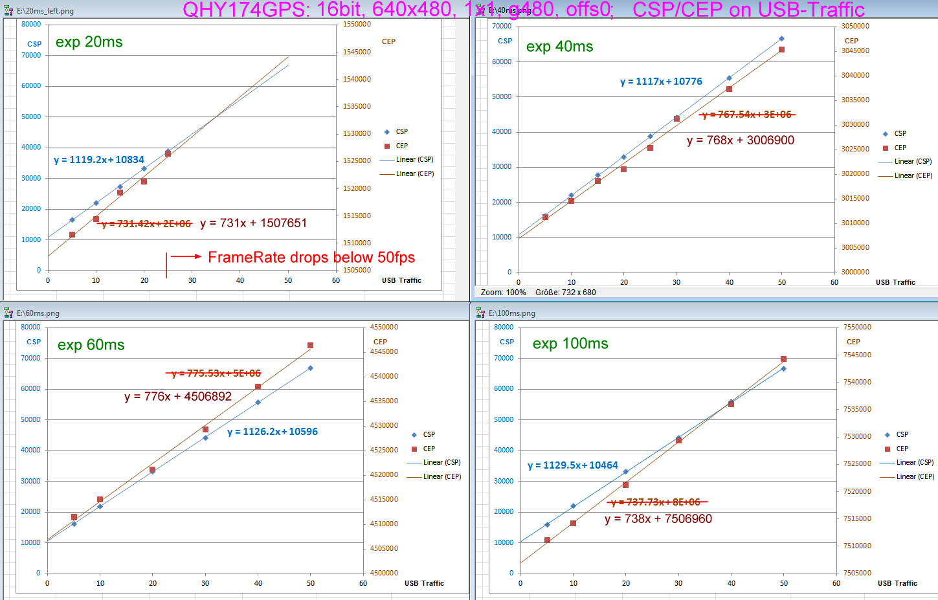
Image credit: Dr. Christian Weber
Notes:
And they led to several weeks of investigation by Christian Weber of IOTA-ES, Robin, and others on the SharpCap forums earlier this year. They played with various settings, seeing how they affected calibrated Start and End Pos values, plotting the results like this.

Slide 24
Results of tests
Correct Start/End Pos values depend on:
Exposure
Binning
Capture Area (vertical extent)
Color Space (MONO8 vs MONO16)
USB Traffic (also USB2 vs USB3 ports)
Formula was derived to roughly predict Start/End Pos based on settings
Notes:
Two main results came out of those tests: First, correct Start/End Pos values depend on several settings: Exposure, Binning, Capture Area, Color Space and USB Traffic, as we’ve noted before. And second, an empirical formula was derived from those tests (the graphs in the previous slide) to attempt to predict Start and End Pos based on those settings.

Slide 25
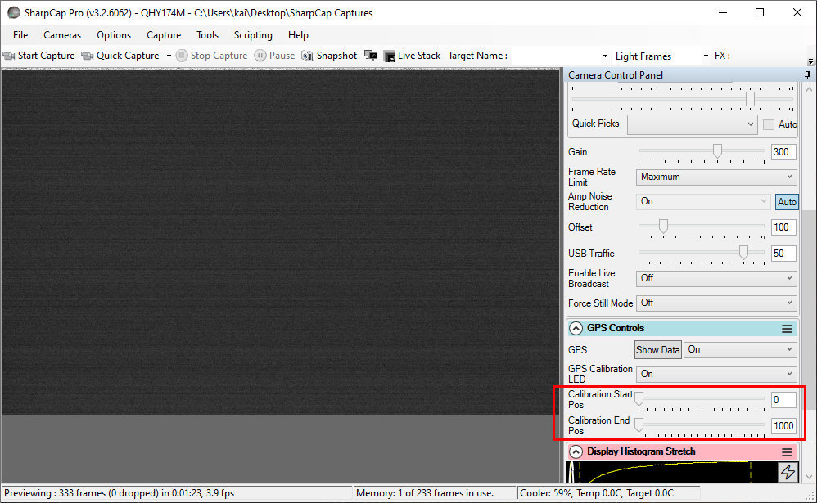
Notes:
This led to changes in the GUI for calibrations. In early versions, such as 3.2.6062, the controls were each just a slider with a number box. And the range was just in the thousands, which sufficed at the time...

Slide 26
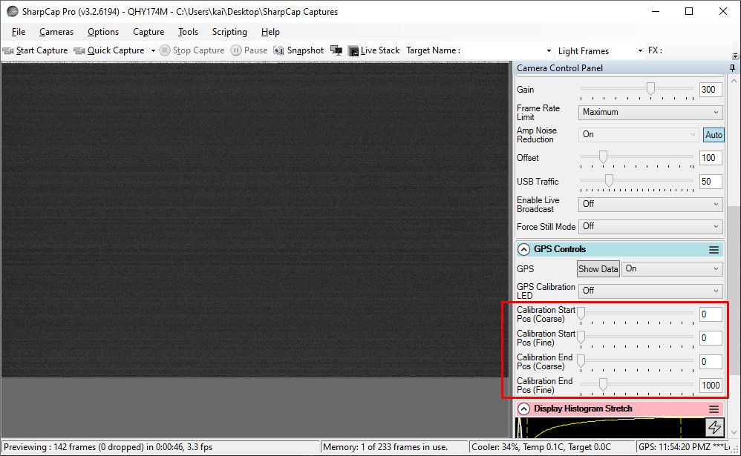
Notes:
..but as these calibration problems were encountered -- and apparently the QHY SDK changed -- the GUI expanded. In 3.2.6194 the controls became a pair of Coarse/Fine sliders for each group, and the range increased to the millions...

Slide 27
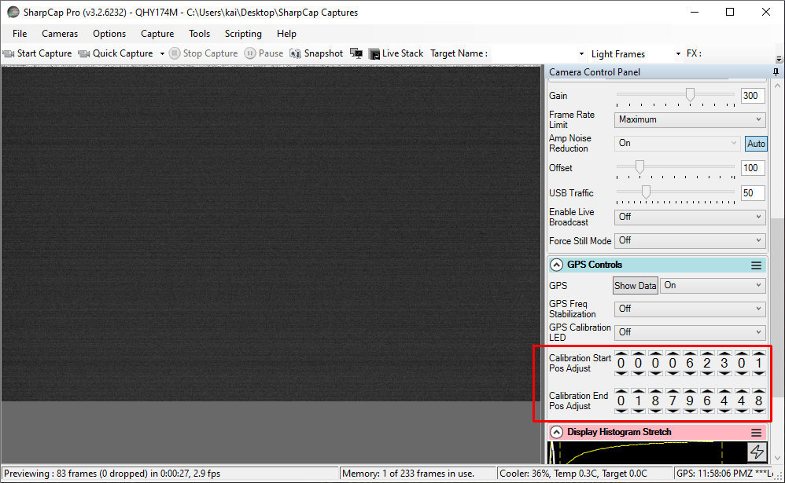
Notes:
...then in 3.2.6232 full control was provided by making each digit individually adjustable, and the range increased still further, to hundreds of millions. Also, about this time, auto-presetting of Start and End Pos when Exposure etc. are changed was added. The goal was to make calibration -- now needed more often because of QHY SDK changes we think -- easier by automatically getting close to the correct values.
So that’s my best guess why we seem to have more calibration problems now, and why the GUI changed: QHY may have changed the SDK, making things more sensitive to calibration, and SharpCap changed the GUI and added presets to try to adapt to those changes. Robin has also said part of it may also be SharpCap changes as he gained more experience with the QHY cameras.

Slide 28
Calibration Problems II
The deep dive: Crazy stuff that requires calibration
Notes:
So ends the side quest. Now let’s get back to looking at calibration-related issues in more detail.

Slide 29
1/6: End Pos cliff
Notes:
The first issue I’d like to talk about is what I call the End Pos “cliff” issue...

Slide 30
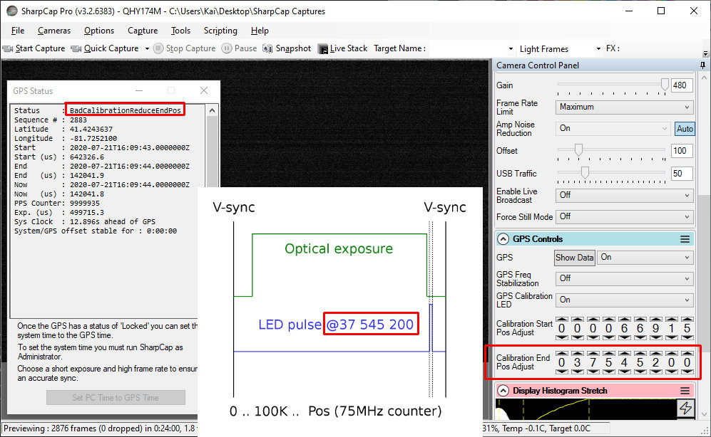
Notes:
Going back the infamous BadCalibrationReduceEndPos error and frozen timestamps. This is not actually a camera error code -- it’s from SharpCap. The camera may actually be GPS locked at this point -- in fact it is in this instance, just look how long it’s been on, at the bottom -- but is nonetheless reporting frozen timestamps. This seems to happen consistently when End Pos is set too high. Because of that, and because we might not notice the frozen times if we only focus on Status (remember, the camera is actually Locked here), SharpCap looks for frozen timestamps when Locked, and when found, changes the Locked status to BadCalibrationReduceEndPos to alert us to calibrate (specifically, to bring down End Pos). Note that this worse that just being off some milliseconds due to wrong calibration: it is complete loss of GPS timing. So we’re alerted to the issue; great. But the other big caveat here is that this freezup can start occurring just above the properly calibrated End Pos value. I’ve seen it start within one or two counts of when the LED fully disappears during the Up-off transition for End Pos, and yet we are supposed to tune to where the LED just appears -- at best 40 counts away. Thus we have a “cliff” of BadCal error and frozen timestamps and it is right up against the proper calibrated value, so we are being drawn to the cliff.

Slide 31
End Pos cliff: BadCal near calibrated value
Solution: Stay back from cliff: Set End Pos down ~1K - ~10K from calibration
No real accuracy issue: even 10K is ~0.13ms
Clock skew could push a close-to-cliff value (50 away) over the cliff -- so stay back
Downside: more susceptible to LED-may-light-when-profile-loads bug (to be discussed)
Upside: more likely to notice and hence work around LED-may-light-when-profile-loads
Versions affected: 3.2.6226+? Unsure
Notes:
So my solution to the End Pos cliff” issue: turn down End Pos a thousand, maybe even 10 thousand, from the proper calibration value, so we stay well back from the cliff. Remember, each count is 1/75th of a microsecond, so A) being off by even 10K should only make the timestamp off by 0.13 millisecond -- perfectly acceptable; and B) the clock could skew in the field due to temperature variations etc., so if we calibrate to within say 50 of the cliff, a 1-microsecond clock skew in the field -- not unthinkable I’d say -- could drift us off 75 counts -- and push us over the BadCal cliff into frozen timestamps. This is conjecture but seems reasonable based on behavior I’ve seen. Downside: this makes use more susceptible to the LED-may-light-when-profile-loads bug, which we’ll talk about
Upside: we are more likely to notice and thus be able to work around the LED-may-light-when-profile-loads bug
Versions affected: this affects 3.2.6226 and later, but I’m really not sure. Note also that older versions might still get the underlying frozen timestamps -- but might report it as Locked. One reason to upgrade.

Slide 32
2/6: BadData can really mean BadCal --
and stay stuck
Notes:
Next issue: a BadData error can actually mean bad calibration -- and worse, it can stay stuck.

Slide 33
Notes:
Ok, so we know to look for BadCalibrationReduceEndPos and calibrate when we see it. But bad calibration can also be reported as BadData, as seen here. Note that I’m at the same settings as the BadCalibrationReduceEndPos error. What’s going on here? Well, two things are combining, and the less important one is hiding the more important one.
First, BadData is reported whenever SharpCap sees the GPS timestamp is more than 24 hours different from the OS time. That’s literally all it means. It has nothing to do with GPS fix: it can be reported with or without a fix. Now, we usually see BadData at startup, when there is no fix. So we’re used to assuming it means there’s no fix, and we just wait for a fix, we get PartialData, then Locked, and we’re off to the races. But if calibration is also too high at the same time as the time is more than 24 hours off, then GPS timestamps also freeze -- the End Pos cliff. But -- and here’s the kicker -- SharpCap prioritizes the stale time problem -- BadData -- over the frozen time problem -- BadCalibrationReduceEndPos. So this combo gets reported as BadData. And we think “hey let’s just wait for GPS fix”. But because the timestamps are also frozen, they remain frozen after GPS fix and thus this issue will never resolve itself until we calibrate. Just look at my runtime at the bottom -- I’ve been on for over 20 minutes -- plenty of time for a GPS fix, And in fact I do have a GPS fix in this screenshot -- but bad calibration masks it.

Slide 34
BadData can mean bad calibration and stay stuck
How it happens:
Camera starts with no GPS fix and bad calibration
GPS time is thus >24 hrs bad (no fix) and frozen (bad calibration)
SharpCap prioritizes bad time as BadData, over frozen time as BadCalibrationReduceEndPos
Camera gets a GPS fix -- but due to bad calibration, time still frozen, so still says BadData
We keep waiting for BadData to resolve, thinking there isn’t a GPS fix
But in this case BadData will never go away until End Pos is calibrated/reduced
Solution: If BadData seen, ensure current settings calibrated before waiting
Caveat: Auto-load Start/End failure bug (discussed next) can compound this
Versions affected: 3.2.6226+?
Notes:
So to recap, here’s how this situation presents itself: The camera starts with no GPS fix and bad calibration -- both of these are needed for this issue. The GPS time is thus bad by over 24 hours (since there is no GPS fix) and frozen (since calibration is bad). SharpCap prioritizes bad time as BadData, over frozen time as BadCal -- thus it reports BadData and hides the more important issue from us. The camera then gets a GPS fix -- but we don’t know this: due to bad calibration, the time is still reported frozen -- and at the old stale value, so it still says BadData. We keep waiting for BadData to resolve, thinking there isn’t a GPS fix. But in this case BadData will never go away until End Pos is calibrated/reduced. This is insidious, because it can look exactly like a situation where we should just wait for a GPS fix -- as BadData is often caused by -- but in this case it’s the wrong answer. Solution: When BadData is seen, make sure the current settings are calibrated; don’t just wait for a GPS fix. However the auto-load start/end failure bug (which we’ll discuss next) can compound this, as we’ll see. Confused yet?
Versions affected: I think this affects 3.2.6226 and later.

Slide 35
3/6: Auto-load profile
can fail to set Start/End Pos
Notes:
The next bug is that the auto-load of a profile can fail to load the profile’s Start/End Pos.

Slide 36
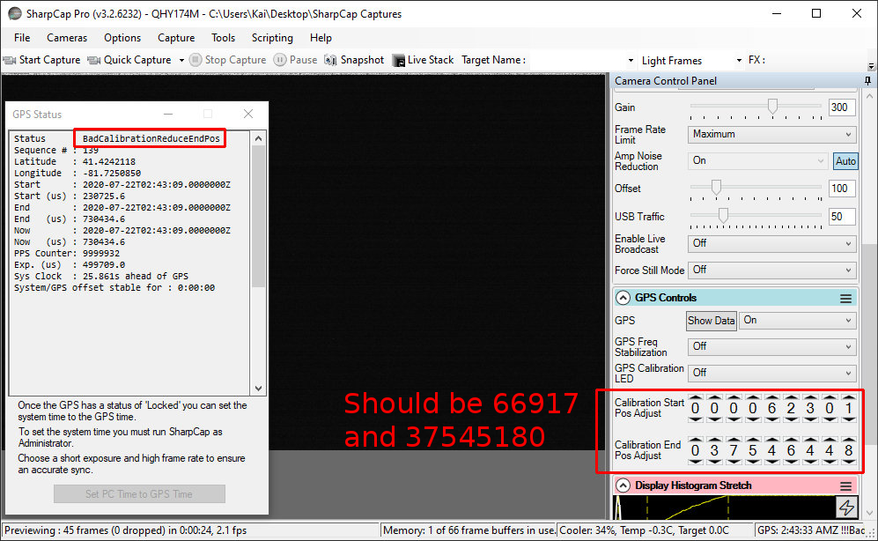
Notes:
When SharpCap attaches to a camera -- either at program start or when told to -- it auto-loads the default profile, if we have one configured. This capture was made just after connecting to the camera, which was already running for some time and thus had a GPS fix. SharpCap correctly auto-loaded most of my default 500ms profile -- which is calibrated. But it failed to apply the profile Start and End Pos, leaving them at the SharpCap auto-preset values -- which happen to be too high for my setup.

Slide 37
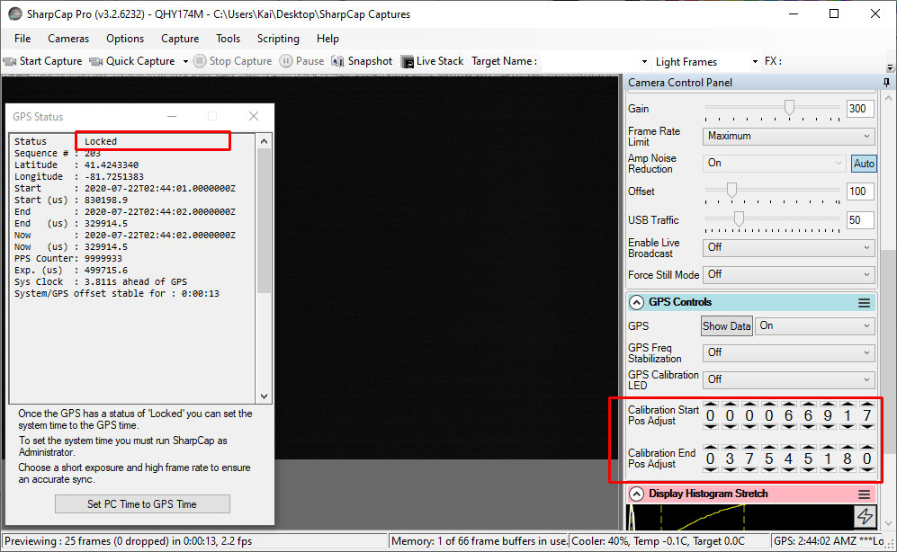
Notes:
If I just hit Load profile, then the Start and End Pos from my profile are applied, and instantly I go to Locked -- because the camera already was Locked, it’s just that the too-high pre-set End Pos was freezing timestamps and preventing it from showing.
Now what’s insidious about this is when it combines with the previous bug -- BadData can mean BadCal and stay stuck. In this example, the auto-load failure left me with BadCal at start -- because the camera already had a fix. But we usually start SharpCap with a cold camera, right? In that case it won’t have a fix, and this auto-load Start/End failure bug will leave us with bad calibration. That leaves us with no fix and bad calibration -- and that combo, as we learned in the previous bug, means SharpCap shows a BadData error -- but it’s really BadCal, and will stay stuck even after GPS fix. So even with a calibrated profile seemingly loaded, we can still end up with a misleading BadData error -- and it may not go away. Fun times.

Slide 38
Auto-load profile fails to set Start/End Pos
Profile auto-load (at camera or SharpCap start) can fail to set Start/End Pos
Insidious: can trigger `BadData can mean BadCal and stay stuck’ issue
Solution: Always hit `Load’ (profile) at camera or SharpCap start
Or upgrade to 3.2.6383+ where it was fixed
Versions affected: 3.2.6248? through 3.2.6377?
Notes:
So to recap: auto-load of profile at camera or SharpCap start can fail to set Start/End Pos; this can be insidious because it can trigger the `BadData can mean BadCal and stay stuck’ issue we just discussed.
Solution: Don’t trust profile auto-load. Always hit `Load’ profile after camera or SharpCap start. But here’s the good news: it was fixed as of 3.2.6383. So another solution is to upgrade to that.
Versions affected: I think this affects 3.2.6248 through 3.2.6377.

Slide 39
4/6: Auto-preset of Start/End Pos
can trigger End Pos cliff
Notes:
The next issue is one that constantly affects me: the auto-preset of Start/End Pos can trigger the End Pos cliff issue.

Slide 40
Image credit: Dr. Christian Weber
Notes:
So remember all those calibration tests I mentioned, that went into determining a formula for auto-presetting Start and End Pos? The relationship is mostly linear, and thus the formula mostly holds up. But it can still be off occasionally...

Slide 41
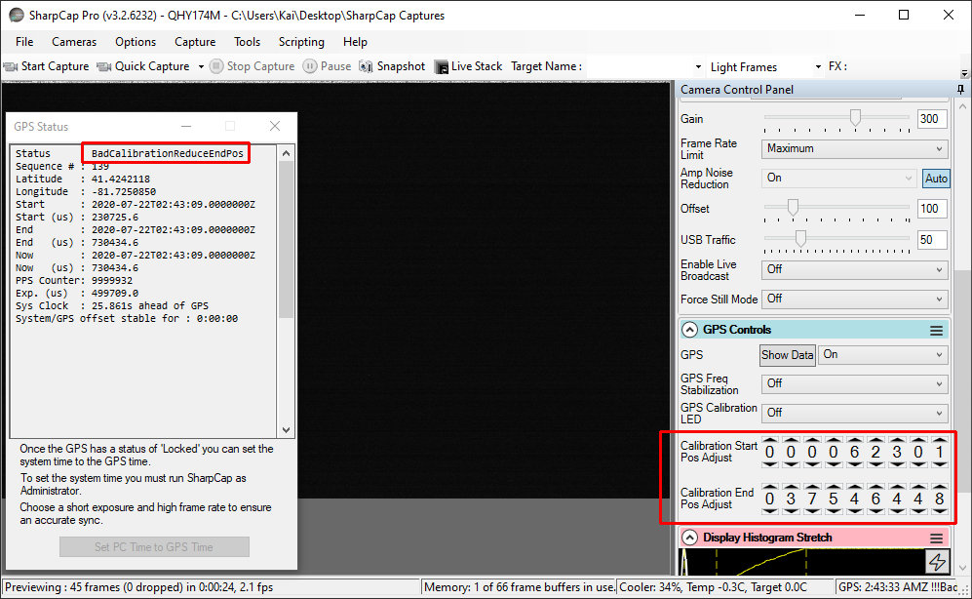
Notes:
...and if it’s off on the high side, even a few hundred, it can trigger the End Pos cliff and thus BadCal and frozen timestamps. I get this All. The. Time. Virtually every change in Exposure triggers BadCal for me, because the presets are just a bit too high. And remember, Start/End Pos auto-presets for changes in Binning, Capture Area, Color Space, and USB Traffic too, so any of those I change, I risk going over the cliff.

Slide 42
Auto-preset of Start/End Pos can trigger End Pos cliff
Exposure/etc. change triggers SharpCap auto-preset of Start/End Pos
If preset too high, can trigger End Pos cliff and BadCal/BadData error
Solution: Calibrate every Exposure etc. combo used for captures, and only capture with a freshly-loaded calibrated profile
Versions affected: 3.2.6226+
Notes:
So to recap: when changing Exposure/Binning/etc. -- the settings that affect calibration -- SharpCap auto-presets Start/End Pos. And if this preset is too high, it can trigger the End Pos cliff and thus give BadCal or BadData
Solution: calibrate every Exposure etc. combo used for captures, and only capture from a freshly-loaded profile. This is highly annoying of course. I do have some thoughts on this that I’ll share at the end.
Versions affected: 3.2.6226 and up

Slide 43
5/6: Profile load may light LED
Notes:
Next issue: profile load may light the LED

Slide 44
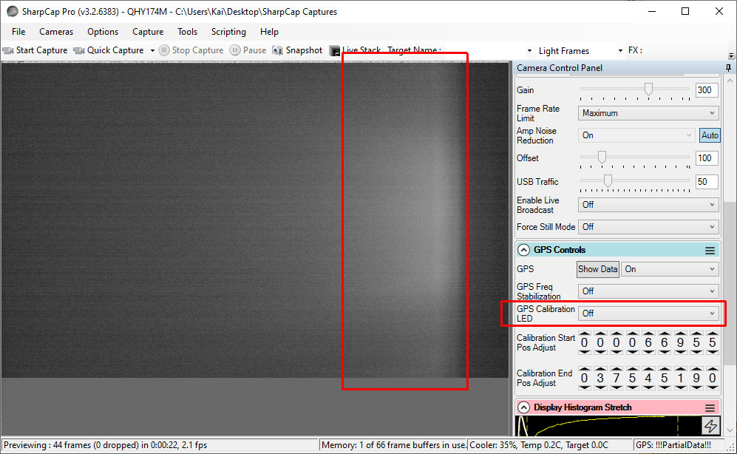
Notes:
Here I’ve loaded a profile, which has GPS Calibration LED off as we see on the right, yet clearly the LED is on. To exaggerate this effect, I deliberately set this profile’s Start Pos high: it seems that when this bug occurs, the LED is usually lit at the Start Pos offset -- but the bug can also trigger for the End Pos time as well. Note that it can be easy to miss seeing the LED when this bug strikes, because we normally calibrate Start Pos to have the LED off -- but maybe we only calibrated it mostly off, like Westley in The Princess Bride. If it’s “mostly” off, that means it’s also slightly alive, er, on, and if it’s slightly on due to this bug during capture, it could affect our data analysis. Unlikely but it’s something to watch for. And we might miss it during captures, when the Gain may not be as high as during calibration.

Slide 45
Profile load may light LED
Profile loads -- either automatically at camera/SharpCap start or manually
LED may be visible despite profile and GUI saying it is off
Might not see it if Start/End Pos calibrated dim
Solution: after loading profile, toggle GPS Calibration LED on then off
Also calibrate profile with Start Pos completely off, and End Pos completely on
This may avoid issue for Start Pos, and make it noticeable (hence fixable) for End Pos
Versions affected: 3.2.6219+
Notes:
So to recap: when a profile loads -- whether automatically or manually -- the calibration LED may be lit, yet the GUI still says it’s off. We might not notice this if Start or End Pos -- whichever the bug chooses -- was calibrated very dim but not off, because the profile Gain will be lower than it was during calibration.
Solution: after a profile loads, toggle GPS Calibration LED on then off. Also, calibrate profiles with the Start Pos completely off, and End Pos completely on: this may avoid the issue for Start Pos, and make it noticeable (so we know to fix it) for End Pos
Versions affected: this affects 3.2.6219 and above

Slide 46
6/6: GPS-reported vs GUI-set exposure
can differ
Notes:
Another issue to watch out for: the GPS-reported exposure length can differ markedly from the GUI-set exposure.

Slide 47
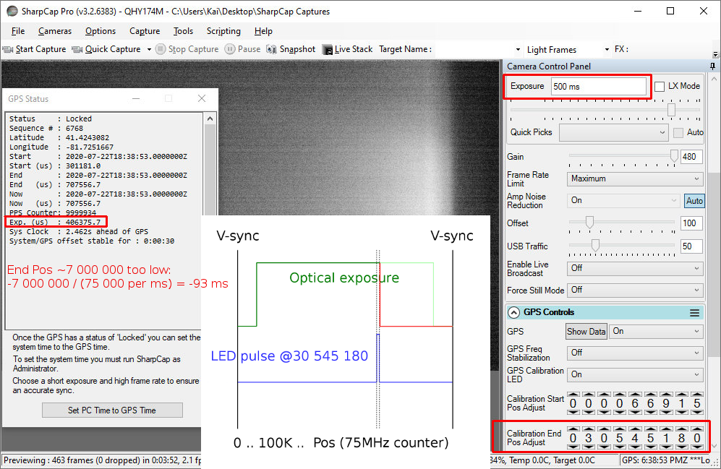
Notes:
This mostly happens where you’d expect: if End Pos is set way too low. Here I’ve set it way low -- about 7 million too low. And the result is my GUI-set exposure of 500ms results in a GPS-reported exposure of only 406 ms. This makes sense if we assume that the End Pos value will indeed cause the exposure to end early if it fires early. And the numbers add up: End Pos is on a 75MHz clock, thus 75K per ms, so 7 million divided by 75K is about 93 ms -- which is what we see. What does this mean for us? When avoiding the End Pos cliff by setting End Pos low, as we did earlier, we can’t just set it super low, like in the millions. But this math does confirm that earlier conjecture that setting it only, say, 10 thousand too low shouldn’t hurt -- we’d only cut the exposure short by 0.13ms.

Slide 48
GPS-reported vs GUI-set exposure can differ
Usually due to real low End Pos (millions too low)
Solution:
Calibrate
Keep End Pos at most ~1K - 10K lower than calibration point when avoiding the cliff
Versions affected: 3.2.6226+? Earlier?
Notes:
So again, this seems to mostly occur with really low End Pos values, like millions too low.
Solution: be sure to calibrate; and keep End Pos at most a few thousand lower than calibration point when avoiding the End Pos cliff
Versions affected: I’m guessing 3.2.6226 and up, but maybe others too?

Slide 49
Calibration Problems III
Issues during calibration
Notes:
Ok, the third -- and last -- set of problems I want to talk about: two things that crop up during calibration itself.

Slide 50
1/2: Third-transition issue
Notes:
One issue I’ve encountered that can really make calibration confusing is what I call the third-transition issue.

Slide 51
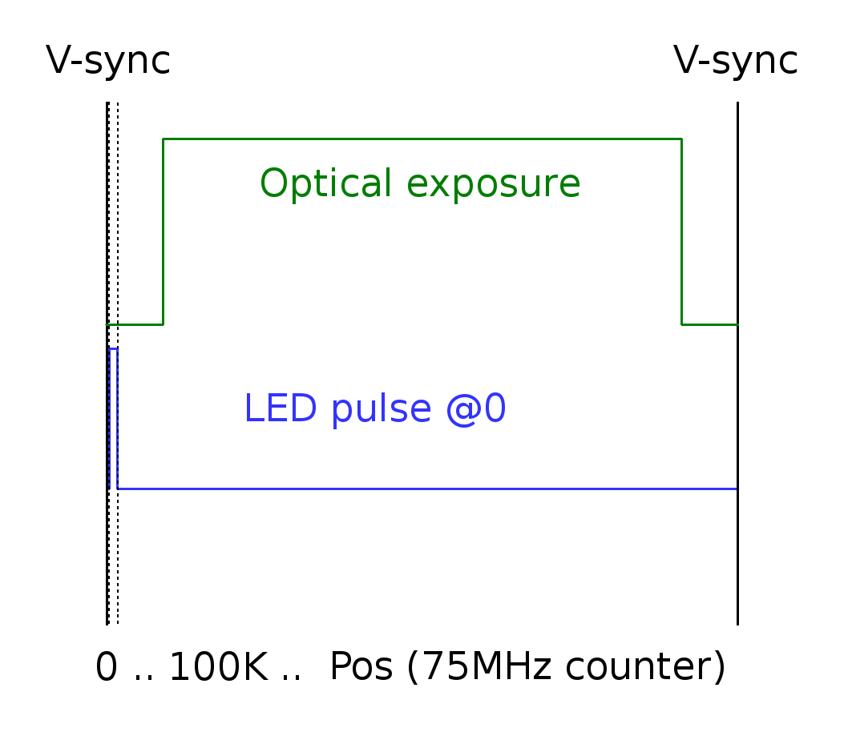
Notes:
Normally, when calibrating we will find two transitions: the up-on transition on the left, for Start Pos and start of exposure, and the up-off transition on the right, for End Pos and end of exposure. And the docs say we should start with Start Pos at 0 and gradually turn it up until it appears. That would imply that Start Pos 0 has the LED off, as this plot shows.

Slide 52
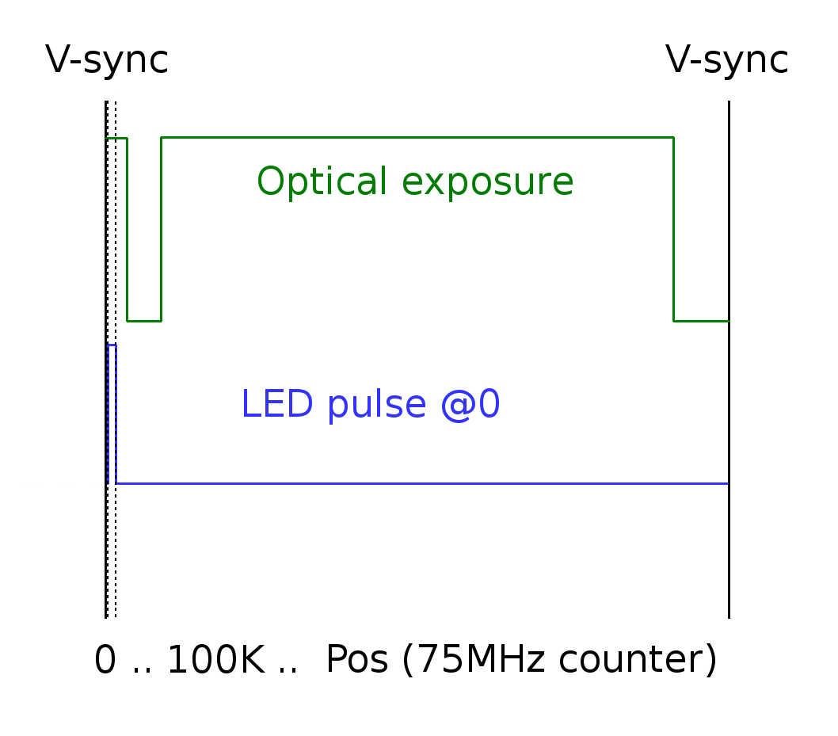
Notes:
But sometimes, I see Start Pos 0 show the LED on, and increasing Start Pos finds an extra third transition, as plotted here...

Slide 53
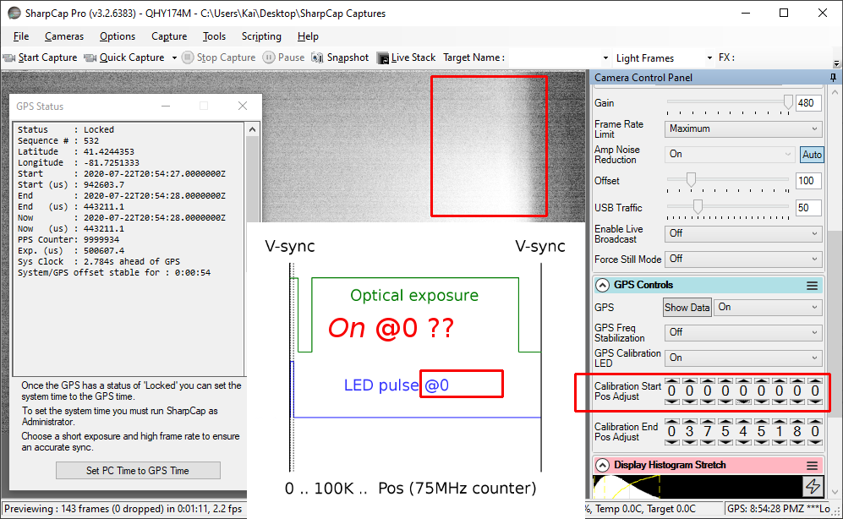
Notes:
So how does this manifest itself? What happens sometimes, is I start calibrating with Start Pos at 0, and see the LED on when I expect it off: I’m in the leftmost edge of the exposure plot, which has this extra on portion in this case for some reason. I increase Start Pos more...

Slide 54
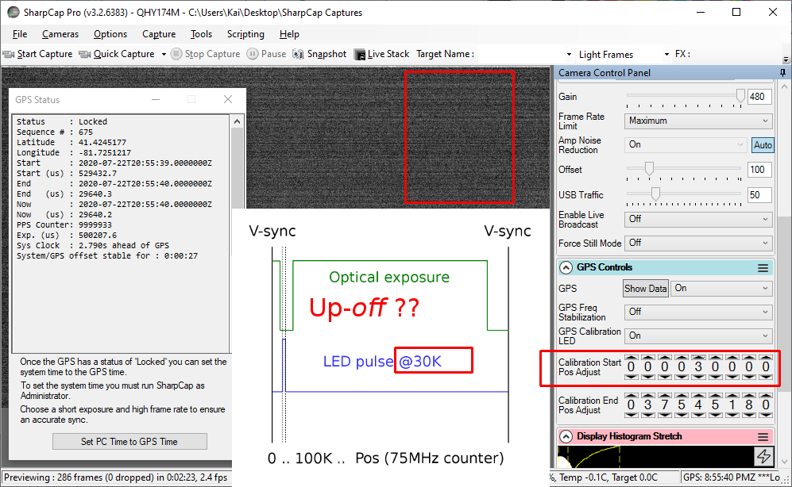
Notes:
..and cross that extra, third transition. But it’s an up-off transition, like end of exposure, not start: waaaht?...

Slide 55
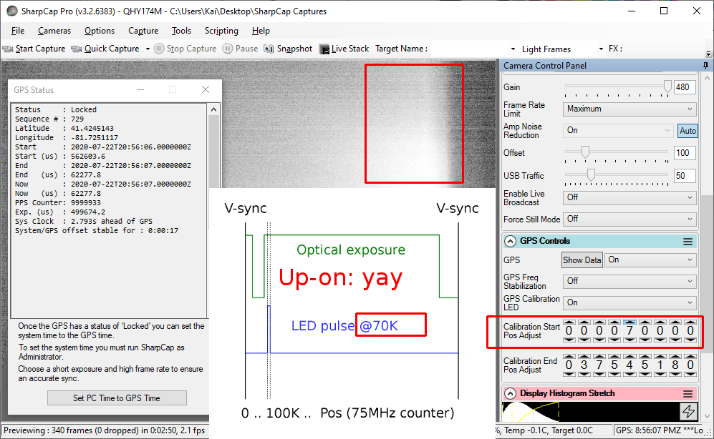
Notes:
...then I increase more, and see the normal up-on Start Pos transition. Then I can center on this up-on transition as normal.
I’ve no idea what causes this, but I’ve seen it on other machines with USB2, where it was way up in the millions. I also don’t know the repercussions on accuracy; I suspect it’s not a big deal, because while I do physically see the LED on during that gap when I stare at the chip -- implying the exposure is off -- I’ve only ever seen a 47K gap, from about 20K to 67K. That’s only half a millisecond, so we probably don’t care.
But we do care about the confusion that this third transition point causes us while calibrating: 1) it can be confusing to see an up-off transition so low, before the up-on start transition: we might think we’ve found end of exposure, and back down (indeed we have found one end, sort of). And 2) if our step increments to Start Pos are too big, we might step right over both the third transition and the normal up-on transition -- missing both, and thus never finding the start of exposure. I.e. if I’d started at 0 like the docs said, but incremented by 100K instead of 10K, I’d have never seen either of those transitions, and would have gone all the way up to the right-most up-off transition, never finding the up-on exposure start transition. Confusing.

Slide 56
Third-transition issue
May find extra, third, up-off transition when calibrating, below start exposure
Confusing if expecting lowest transition to be up-on for Start Pos
Solution:
Check Start Pos at 0: is LED on? Normally off
If LED on, extra third up-off transition is present and must be found and skipped first
Try to find it with small steps -- 10K or less -- or might miss it
Then proceed to find normal up-on Start Pos transition
Versions affected: 3.2.6219+?
Notes:
So to summarize: sometimes there is an extra, third, up-off transition when calibrating, and it seems to occur before the other two, possibly pushing them up higher. It’s confusing to come across when you’re expecting the first transition in the low counts to be up-on for Start Pos.
Solution: Set Start Pos to 0: if the LED is on, a third transition exists, and you need to look for it and skip it. But use small steps -- 10K or less -- or the steps might skip both the third (up-off) and normal (up-on) transitions. Once found, continue skipping up to find normal up-on Start Pos
Versions affected: 3.2.6219+ I think.

Slide 57
2/2: LED goes bright or off for one frame
Notes:
Another confusing thing while calibrating: the LED can go bright, or off, for just one frame. Have you ever had this happen while calibrating?...

Slide 58
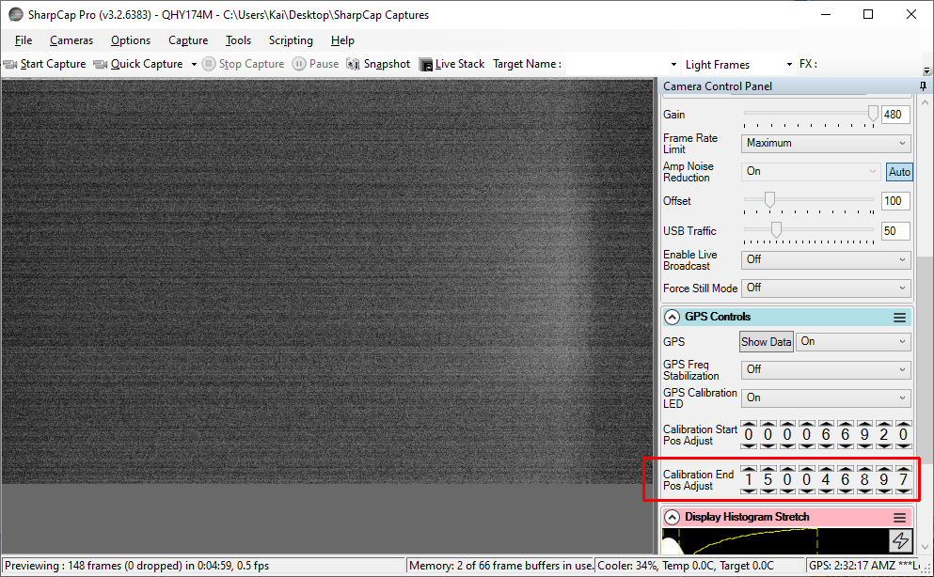
Notes:
The LED is partially on, or maybe off. And you’re about to touch one of the counters, let’s say End Pos...

Slide 59
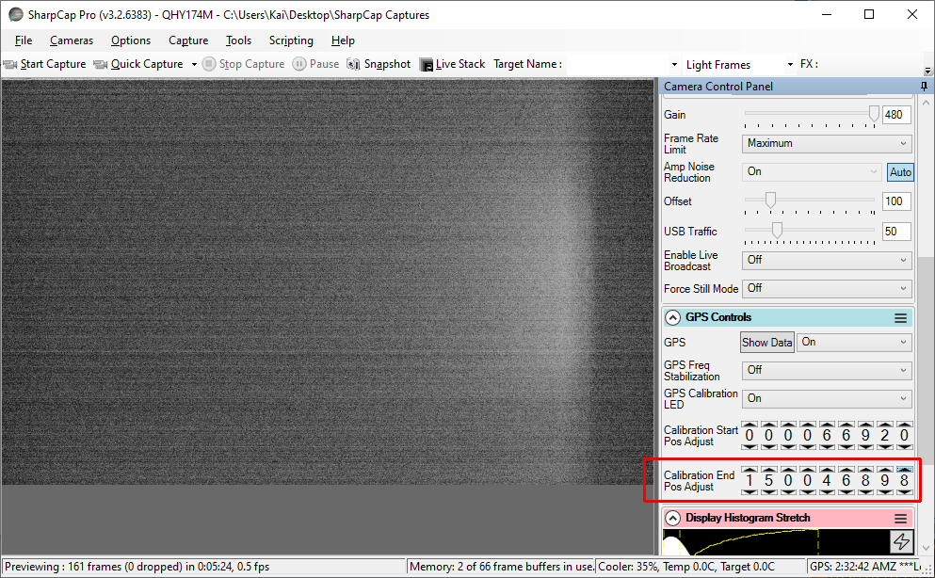
Notes:
..then you do so, bumping up End Pos in this case, just a small amount -- one. You expect the LED to go dimmer -- because you’re increasing End Pos. But instead it goes brighter, as we just saw. Then, you do absolutely nothing, and one frame later...

Slide 60
Notes:
...the LED goes dimmer again, without you doing anything. Note that all settings are the same here as the previous slide: Start Pos, End Pos, Gain, histogram. I touched nothing. Seems unpredictable. What is going on? Well, I think I understand this...

Slide 61
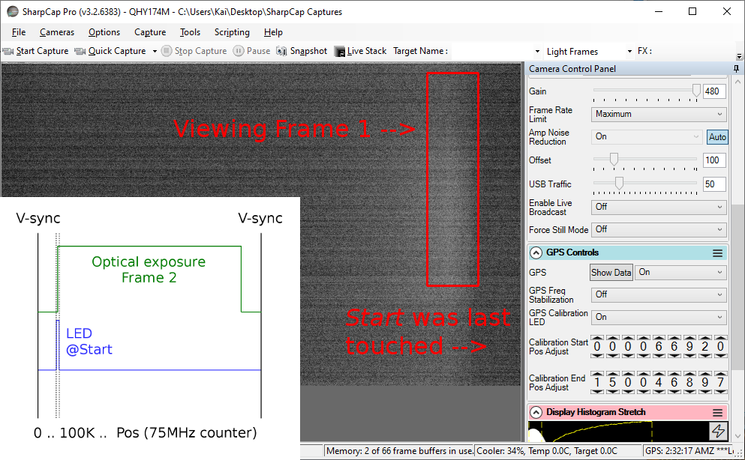
Notes:
Initially, before I hit End Pos, I had forgotten that the last thing I’d touched was actually Start Pos. So the LED blink we saw in the first slide was at the Start offset -- which was close to calibrated, so it was half on. More importantly, it was at a low value, so it blinks early in the exposure. So here we’re midway through exposing Frame 2, let’s say it’s right at the center point. So that Frame 2 exposure has already seen the Start blink. Now I get ready to bump End Pos up by one -- at the middle of the exposure as I said...

Slide 62
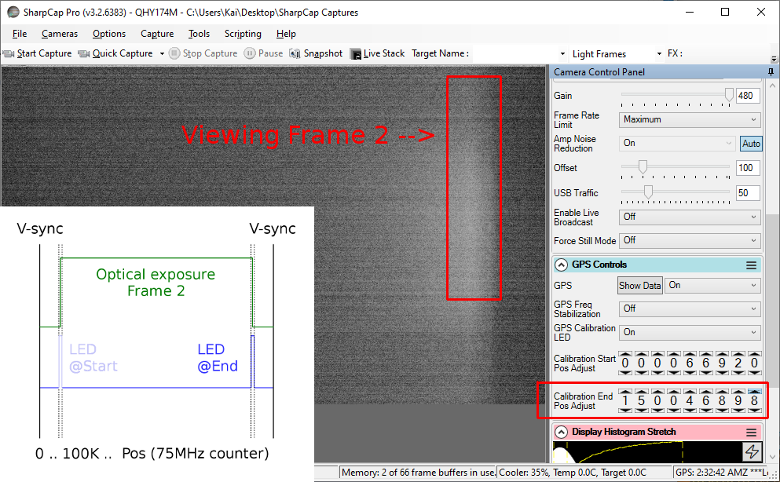
Notes:
..and that immediately switches the blink to the end of the frame -- where End Pos is set. Because we’re in the middle of exposing frame 2 at that point, that blink is “ahead” of the exposure, i.e. in the future. So the frame 2 exposure will catch it -- but remember, it’s also caught the Start blink earlier, ‘cause we’re still on the same Frame 2 exposure. So we have a double exposure.
Then Frame 2 ends, and it gets displayed: we see the double exposure as the LED brightening...

Slide 63
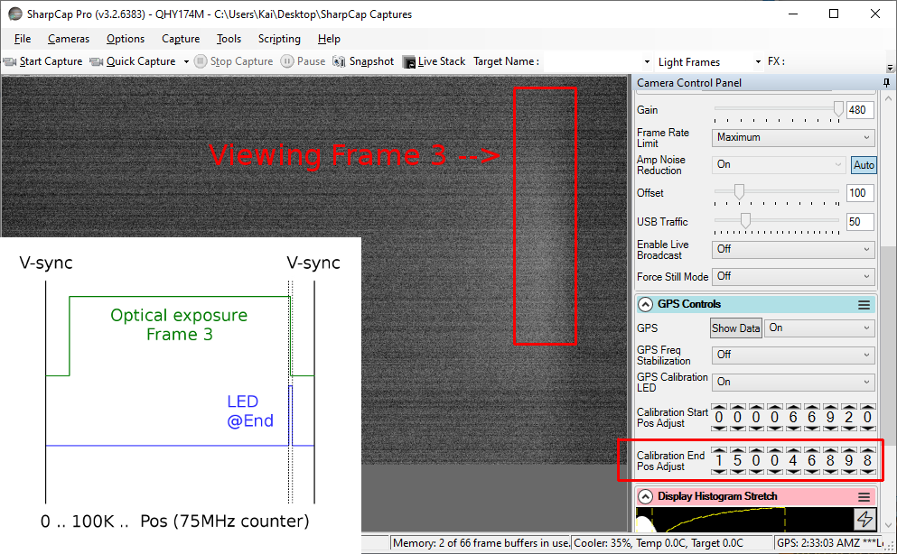
Notes:
..Then we do nothing, and the very next frame, we see the LED dim. Because now it’s starting a whole new Frame 3 -- which only has the End blink, not the after image of the start blink as well. Remember, there’s only one blink per frame -- unless we move it, like we did here.
So basically, if we move the single blink forward in time -- we increase the counter and skip it from the past to the future during a frame -- it can get double-exposed and make the LED look brighter. In this case I did it by switch from a low Start Pos to a high End Pos. But it could just as easily happen by moving from a low to high value on the same group. For example, I could have stayed on Start Pos the whole time, and just jumped it a large counter value, say 100 million. If I timed it right, that would move the blink from the past (already exposed) to the future (to be double exposed).
Similarly, by decreasing the counter a lot, we could move the blink from the future (not yet exposed) to the past (too late to expose) -- and thus it would appear to go out for one frame. I think timing issues like this explain the occasional random LED brightening or going out for one frame that we see.

Slide 64
LED goes bright or off for one frame
Counter increment can push LED blink into the future: double-exposed LED
Counter decrement can push LED blink into the past: no exposed LED
Solution: Ignore it, just a one-frame unlucky timing thing
Versions affected: 3.2.6226+?
Notes:
So, to recap, the LED can go bright or off for just one frame mysteriously. This is caused by either a counter increment pushing the blink into the future, causing a double exposure and thus brightening, or a decrement pushing the blink into the past for no exposed LED.
Solution: just ignore it, it’s a one-frame one-off.
Versions affected: 3.2.6226+? Maybe all versions? Dunno

Slide 65
Best Practices
Avoid some problems, deal with others
Notes:
Ok so enough with all the problems. Let’s summarize some solutions -- the part you’ve been waiting for, so you want to wake back up now. While I don’t have fixes for everything I discussed, and I’m sure there are issues I haven’t even mentioned, I do have best practices to deal with some of what I know.

Slide 66
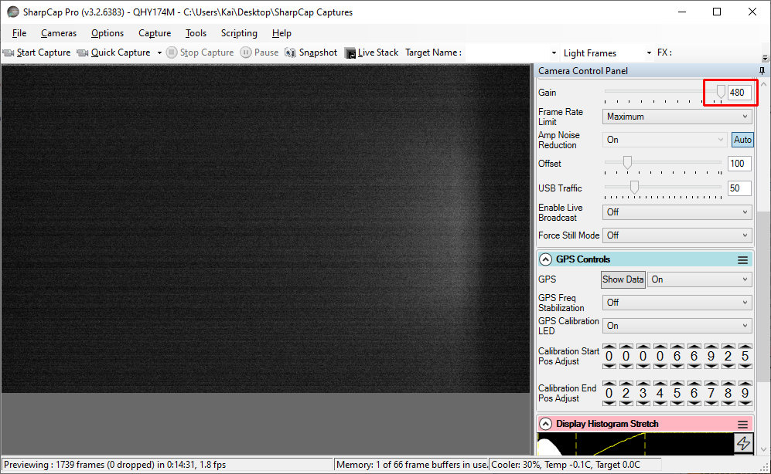
Notes:
First, some tips while calibrating. Set the gain high so that the LED is more clearly visible when only partially on during the exposure. Newer SharpCap versions -- from 3.2.6232 up -- do this automatically whenever the LED is turned on via GPS Calibration LED (and then they restore the previous version when the LED is turned off). Gain is not one of the settings that affects calibration, so it’s safe to play with.

Slide 67
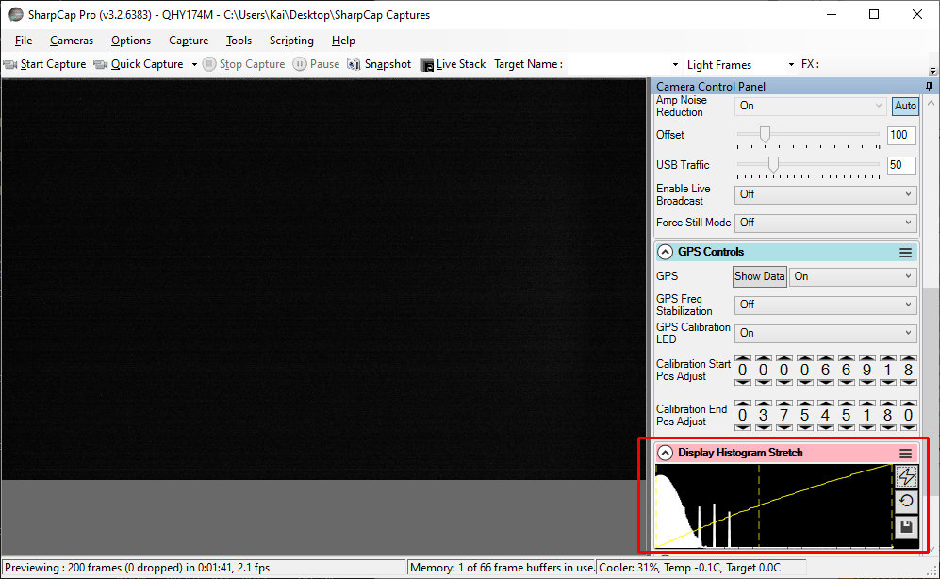
Notes:
Use Display Histogram Stretch to increase contrast so the LED shows up when faint. Looks like the LED isn’t on, right?...

Slide 68
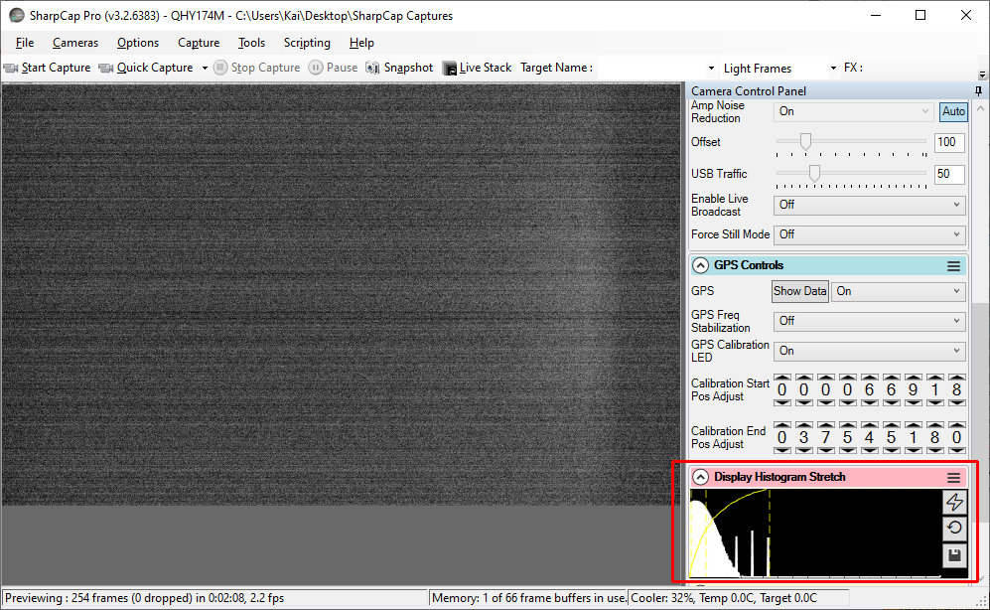
Notes:
…well it is, partially, if you increase contrast with histogram stretching. This is a good reason to upgrade to Pro by the way -- you get the Auto Histogram Stretch button (lightning bolt) to automatically stretch the histogram to improve contrast. Again, doesn’t affect calibration.

Slide 69
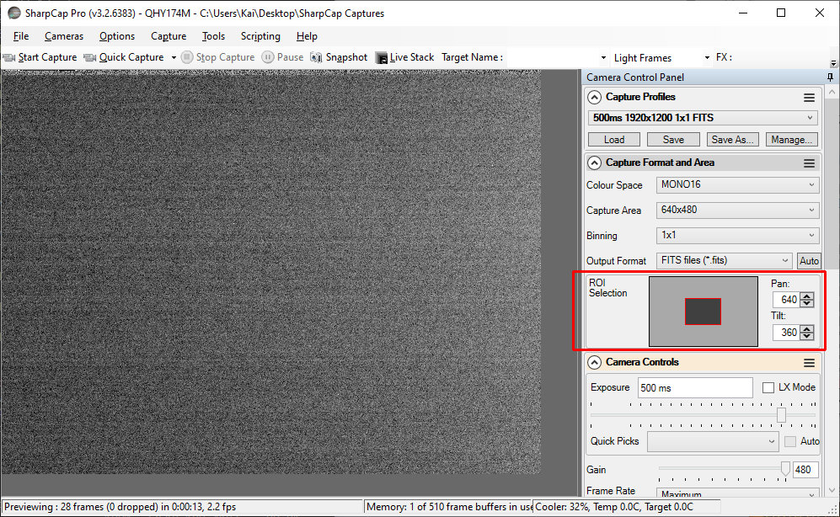
Notes:
If calibrating for a smaller capture area / ROI, it can be difficult to see the LED because it does not evenly illuminate the frame. Since it’s mounted to the right side, it lights the right side more than the center. So a small ROI in the center may not see it lit well...

Slide 70
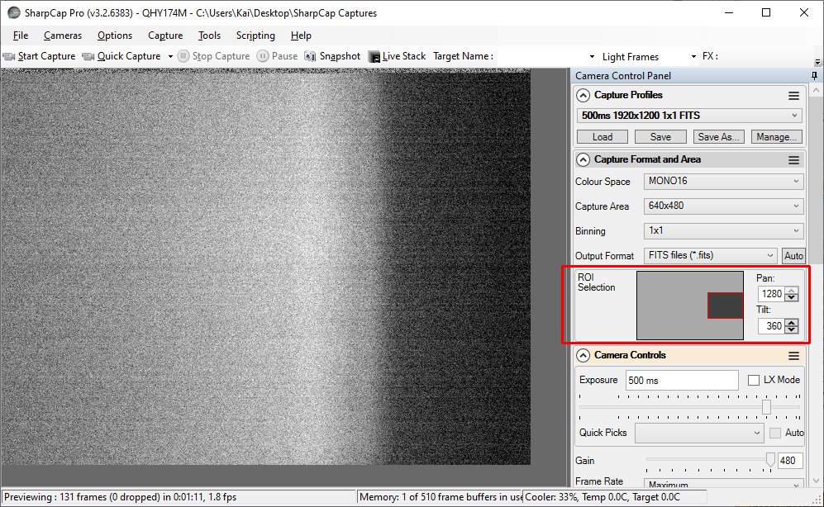
Notes:
… so move the ROI to cover the right side of the frame. For really small ROIs -- below 200 pixels or so wide -- don’t go full right: be sure the area 200 to 400 pixels from the right side is viewable. Note that moving the ROI like this will not affect the calibration values: only the size of the ROI affects it -- specifically, the height.

Slide 71
Best practices I -- while calibrating
Whack the Gain high to see the LED better (some versions do this already)
But turn it back down before saving profile
Use Display Histogram Stretch to see the LED better
Move small ROIs to the right to see LED better
Notes:
So again, to summarize on one slide -- this is the first of those three best practices slides I promised: set the Gain high -- but turn it back down when saving. Use histogram stretch to see the LED better; and move small ROIs right to see the LED better.

Slide 72
Best practices II -- configuring at home
Upgrade to 3.2.6383+ -- fixes auto-load of profile not setting Start/End Pos
Make calibrated profiles for every exposure etc. combo to be captured
Affected by Exposure, Binning, Capture Area, Color Space, USB Traffic, Start Pos, End Pos
When calibrating, first check for and skip possible third transition
Set Start Pos 0: is LED on? Then first look for third transition (using small steps -- 10K)
Leave Start Pos below (~1K - 10K) calibrated value
Helps avoid profile-load-may-light-LED bug; little accuracy effect (< 0.2 ms)
Leave End Pos below (~1K - 10K) calibrated value -- important
Keeps away from End Pos cliff (BadCal / frozen timestamps), little accuracy effect (< 0.2 ms)
May help alert you in the field to profile-load-may-light-LED bug
Ensure LED is turned off, and Gain is back to 300, before saving profile
Notes:
Next let’s look at configuration at home before we set out. First, if you’re already using a recent version of SharpCap, upgrade to 3.2.6383 (July 4) or later, as it at least fixes the bug of auto-load profile not setting Start/End Pos. Make calibrated profiles of every exposure etc. combo you’re likely to capture with in the field. Remember, calibration is affected by these settings. I know this sucks, but it avoids having the auto-presets for Start/End Pos go wrong and send you into frozen timestamps when you change exposure. When calibrating, check for and deal with a possible third transition by setting Start Pos to 0: if the LED is on, you’ve got a third transition (up-off) that needs to be skipped first. It will be before the normal start transition (up-on), and probably close to it (40K or so), so use small steps. When you then proceed up to the actual start exposure transition and find your Start Pos, leave Start Pos low by 1K - 10K: this helps ensure it does not show if the profile-load-may-light-LED bug strikes in the field. After you get a calibrated End Pos value, also leave End Pos down 1K - 10K to stay away from the End Pos cliff that causes BadCal or frozen timestamps; this is probably the most important recommendation I have. It may also help alert you to the profile-load-may-light-LED bug in the field. Lastly, make sure the GPS Calibration LED is off, and Gain is 300 or whatever you prefer, before saving the profile. Remember that recent versions of SharpCap automatically whack Gain up to 480 when you turn the LED on, and reset it when you turn it off. But earlier versions do not, and it’s a wise check in any version.

Slide 73
Best practices III -- in the field
Hit `Load’ [profile] after camera/SharpCap start, to ensure Start/End Pos set
Works around bug prior to 3.2.6383: auto-load of profile does not set Start/End Pos
Only capture from freshly-loaded calibrated profile (no settings changes after)
Avoids auto-presets maybe causing BadCal / BadData / frozen timestamps
Watch preview after profile loads for lit LED (profile-load-may-light-LED bug)
If visible, must toggle GPS Calibration LED on then off to turn it off
Watch for signs of bad calibration:
BadCalibrationReduceEndPos of course
BadData that doesn’t go away: always manually load a calibrated profile
Frozen GPS timestamps that don’t update (might not get error Status in older versions)
GPS-reported exposure different than GUI-set exposure (will not get an error Status)
Notes:
Finally, my best practices in the field. Hit Load profile after the camera or SharpCap starts, to ensure Start/End Pos is set from the profile. This works around a bug in versions prior to 3.2.6383. You can skip this if running 3.2.6383 or later, or keep doing it if paranoid. Only capture from a freshly-loaded profile: no settings tweaks before capturing, as that can make the auto-presets to Start/End Pos cause BadCal / BadData and frozen timestamps. Watch the preview for a lit LED after loading a profile: could sometimes be lit even if profile sets it off. If you see it, toggle the LED on then off to turn it off. And watch for signs of bad calibration: BadCalibrationReduceEndPos of course. But as we’ve learned, end-pos-too-high can also manifest itself as BadData -- and it might not go away after GPS fix, if the current settings are not calibrated. So always manually load a calibrated profile. Frozen timestamps that don’t update from frame to frame -- this should change GPS Status to BadCal or BadData in recent versions, but I think in older versions it might still say Locked. And GPS-reported exposures that differ from the GUI-set exposure: I don’t think any version reports an error for this, but End Pos set way low (millions) can reduce exposure significantly.
So, these best practices unfortunately don’t fix everything, but they do address about everything I know how to address at this point.

Slide 74
Future work
Further accuracy checks
SharpCap + QHY174 has been SEXTA’d by Marc Buie, Christian Weber, others
But what SharpCap version was that?
Explore further: plot Start, End Pos vs accuracy. How far off is still good? (~10K = 0.13ms?)
Does accuracy change with SharpCap/QHY versions?
How accurate is GPS-reported Exposure when deviating from GUI-set? Short exposures?
Bug fix/workaround wish list
Ability to adjust Start/End auto-preset formula: could stay accurate and avoid End Pos cliff
Auto-tune End Pos?
Always report frozen timestamps as BadCal, even when stale: i.e. override BadData
Report GPS exposure significantly deviating from GUI-set exposure?
Fix for profile-load-may-light-LED bug?
Notes:
And the second to last slide -- future directions. A few things I’d like to see worked on. First, more accuracy checks. Yes, the QHY has been SEXTA’d by Marc Buie, Christian and others. But what version was that for? And let’s explore the Start and End Pos space more: plot Start Pos vs accuracy, and End Pos vs accuracy: how far off can Start or End be and still be accurate enough? I.e. is my 10K = 0.13ms hunch correct? Does accuracy change with SharpCap version? How accurate is the GPS-reported exposure when it starts deviating from the GUI-set exposure? How accurate are short exposures? Christian Weber of IOTA-ES has reported timestamp errors measured with an EXTA of 20 to 60 ms or more, with short exposures (20-50ms), with 3.2.5986.
And of course, bug fixes or workarounds. My best practices now are a lot of work to avoid bugs; how can we reduce this? My biggest wish list item is the ability to tweak the auto-preset formula. If we can adjust that, as a global setting, we might be able to set it to stay on the safe side of the End Pos cliff, yet still be acceptable accurate, and never have to calibrate for every exposure. Next best, and perhaps in addition, would be an auto-tune for end pos: if BadCal is detected, just automatically reduce End Pos, possibly with a binary search. But the third-transition issue might make this tough, and long exposures would cause a longer wait for it to settle. Next I’d like frozen timestamps always reported as BadCal: I think they are always a result of End Pos too high, and it’s much clearer than sometimes reporting as BadData, which usually means “just wait for a GPS fix” -- the wrong action in these cases. Also, perhaps report GPS exposure deviations from GUI-set exposure? With really low End Pos values, they can vary significantly. Lastly, a fix for the profile-load-may-light-LED bug: this happens sporadically but often for me.

Slide 75
References / Resources
SharpCap forums at forums.sharpcap.co.uk, especially:
QHY 174 GPS Calibration LED issue // USB Traffic weirdness thread
Dr. Christian Weber’s IOTA-ES Berlin workshop notes on the QHY174:
https://www.iota-es.de/qhy174gps_workshop.html, especially part 2
QHY docs on calibration
Notes from Joan Dunham, Roxanne Kamin, John Moore, and others - thanks
Notes:
And finally -- yes this is my very last slide -- some useful resources that helped with this presentation. First, the SharpCap forums have useful info, and are great place to ask questions. They are moderated by Robin Glover, who wrote and maintains SharpCap, and who answers questions promptly. Dr. Christian Weber’s IOTA-ES Berlin workshop presentation on the QHY174 was very helpful, especially the second part on calibration. QHY has some documentation on calibration though it can be a bit unclear and confusing to me. And finally, last but not least, thanks to Joan Dunham, Roxanne Kamin, John Moore and others who’ve shared their calibration values and experiences with me; I still can’t claim to understand all of this, but their input has helped.
That’s it. I hope that at least some tiny part of this was more helpful than confusing.
Questions?

